Slide 1
Hydrorock
Filter Gullies
www.hydrorocksolutions.com

Slide 2
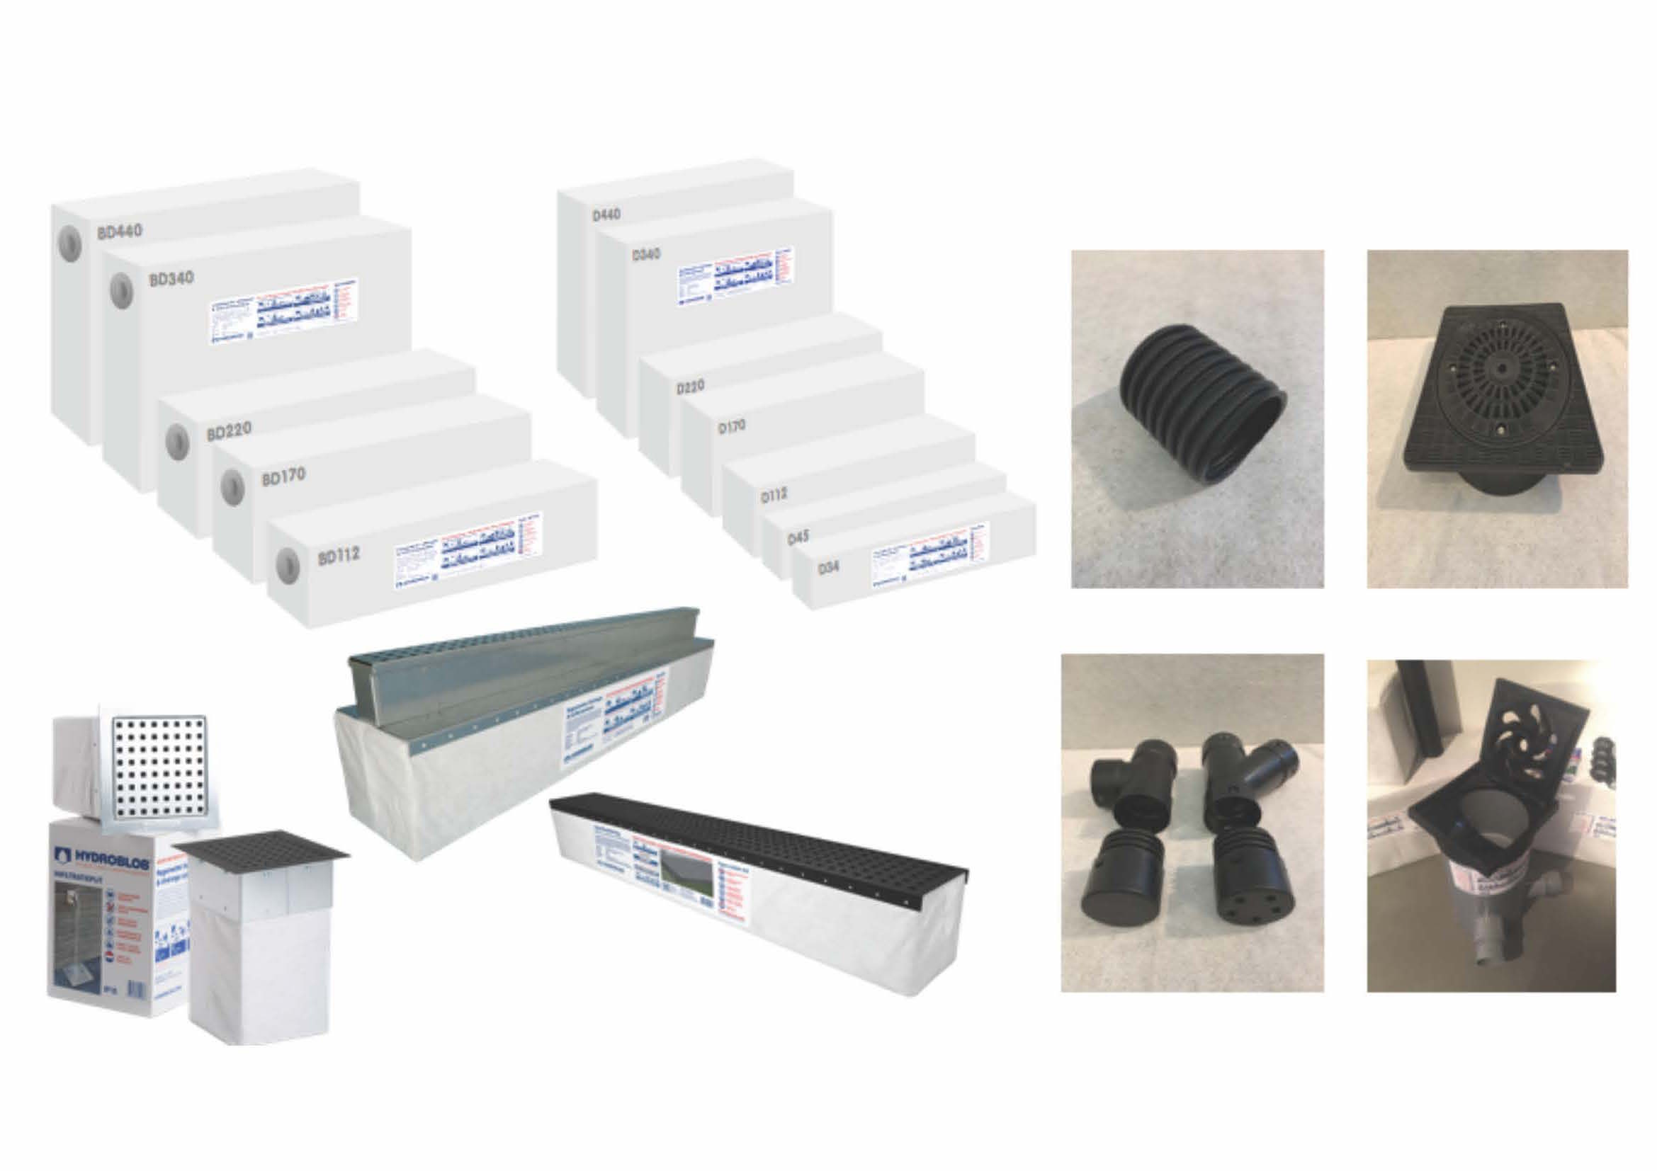
Hydrorock Modular System provides installation flexibility of gravel with the water void ratio of crates

Slide 3
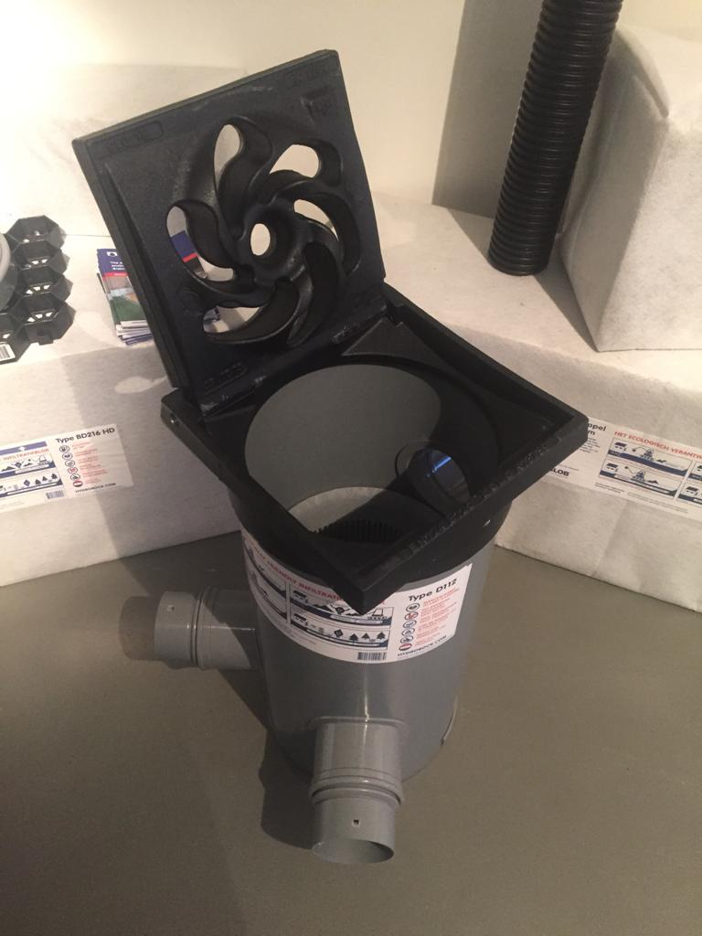
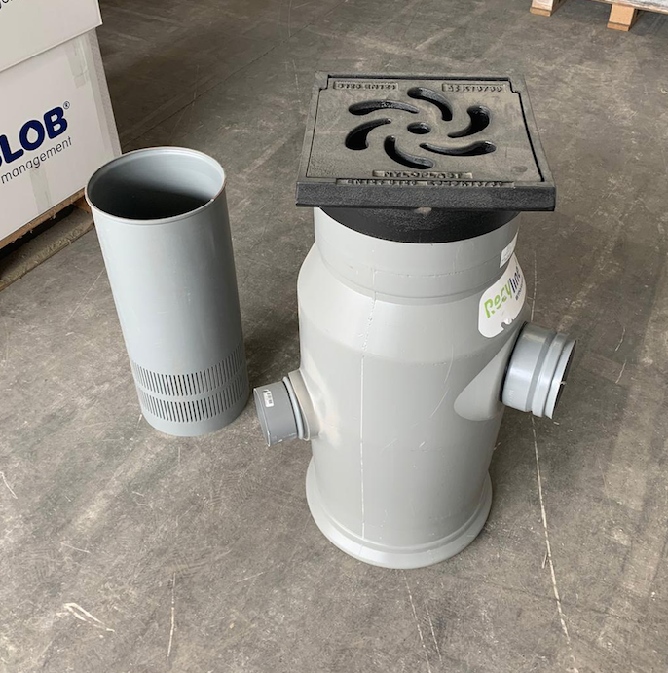
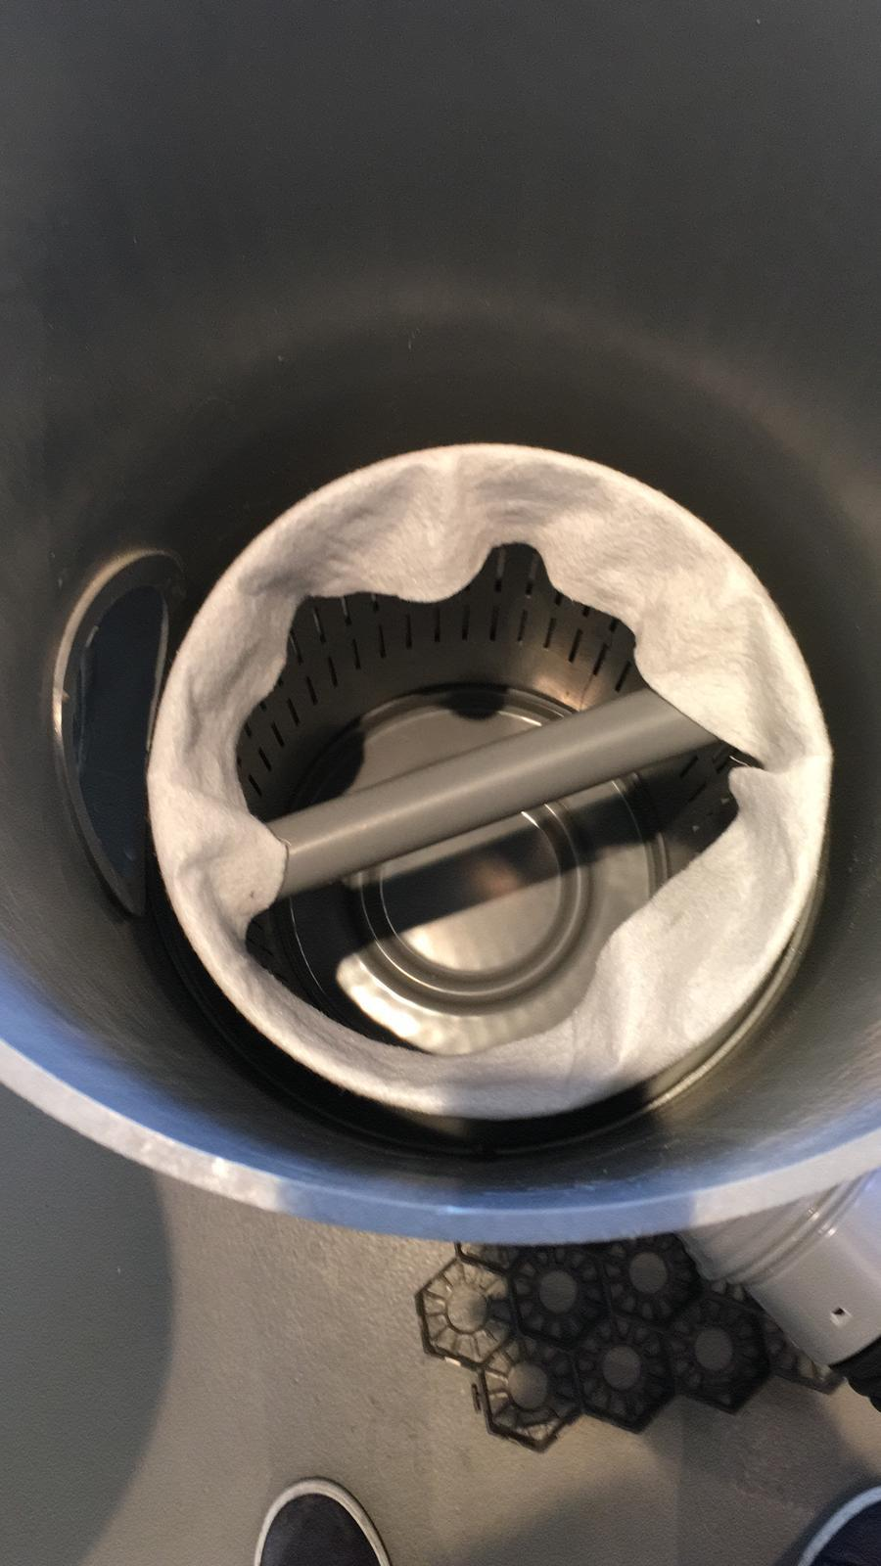
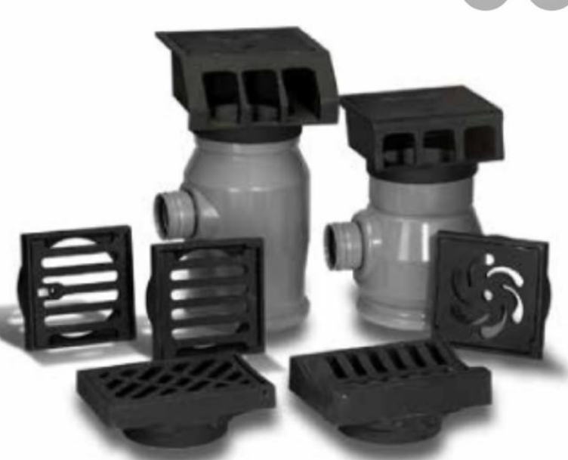
Hydrorock Modular System comprises a selection of Filter Gullies of varying sizes for varying purposes
Hydrorock Filter Gullies can be surface fed / subsurface fed / or both simultaneously
Internal filter unit covered by a geotextile ‘sleeve’ prevents silt and other extraneous material reaching Hydrorock Blocks – filter unit and ‘sleeve’ can be readily removed for fast / simple cleaning if necessary

Slide 4
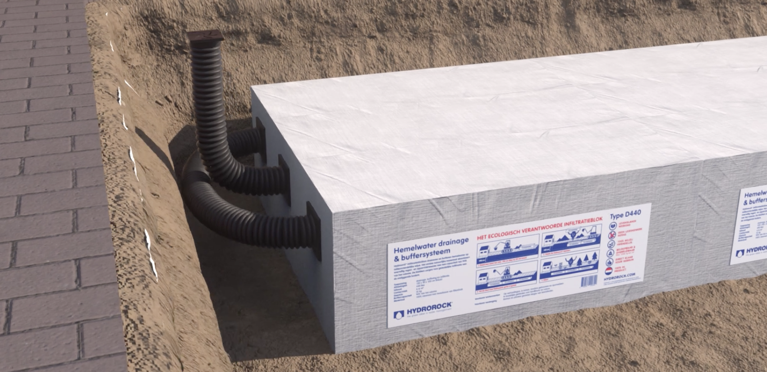
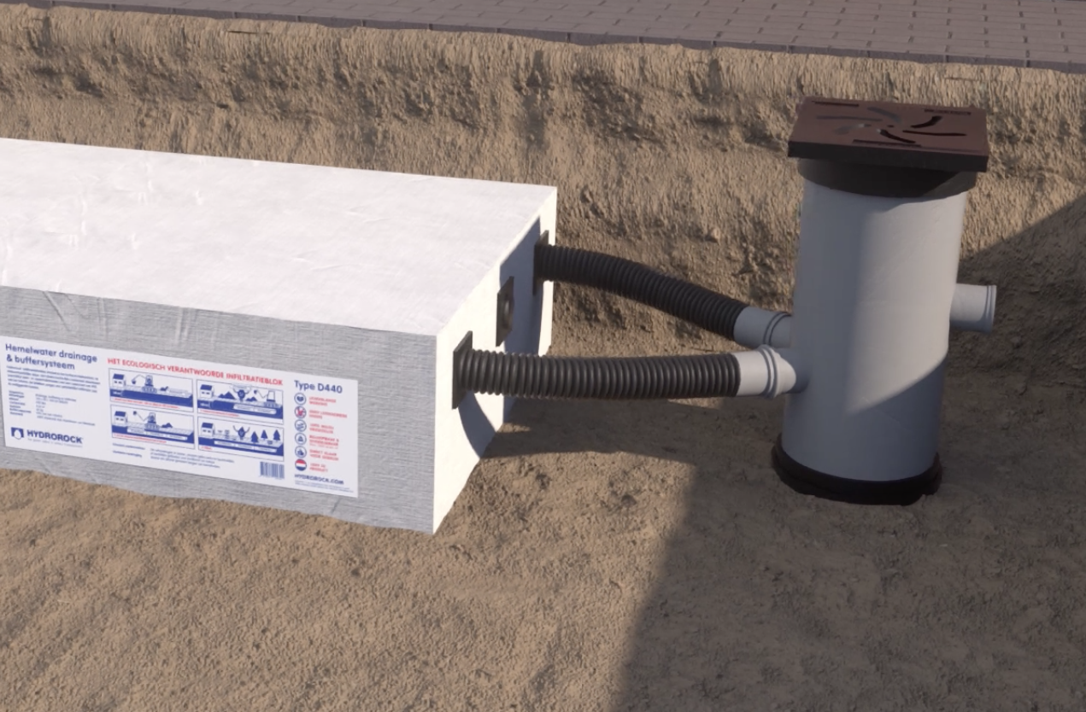
Hydrorock Modules can be surface fed or subsurface fed from one end (using 1 Filter Gully) or both ends simultaneously (using 2 Filter Gullies)

Slide 5
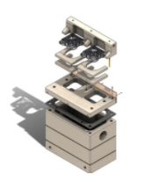
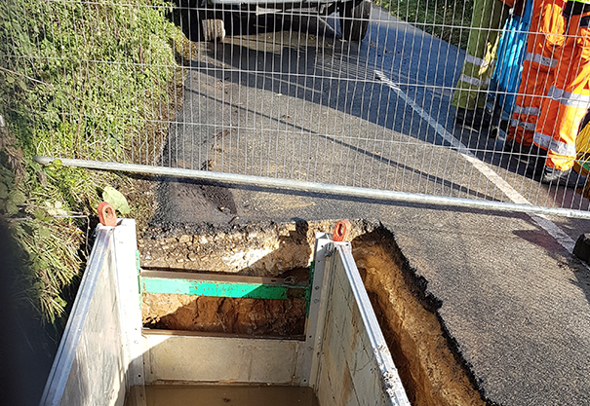
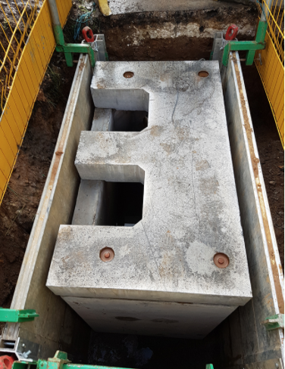
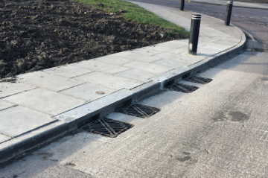
Super Gullies installed under gutter of road feed Hydrorock Modules under adjacent verge

Slide 6
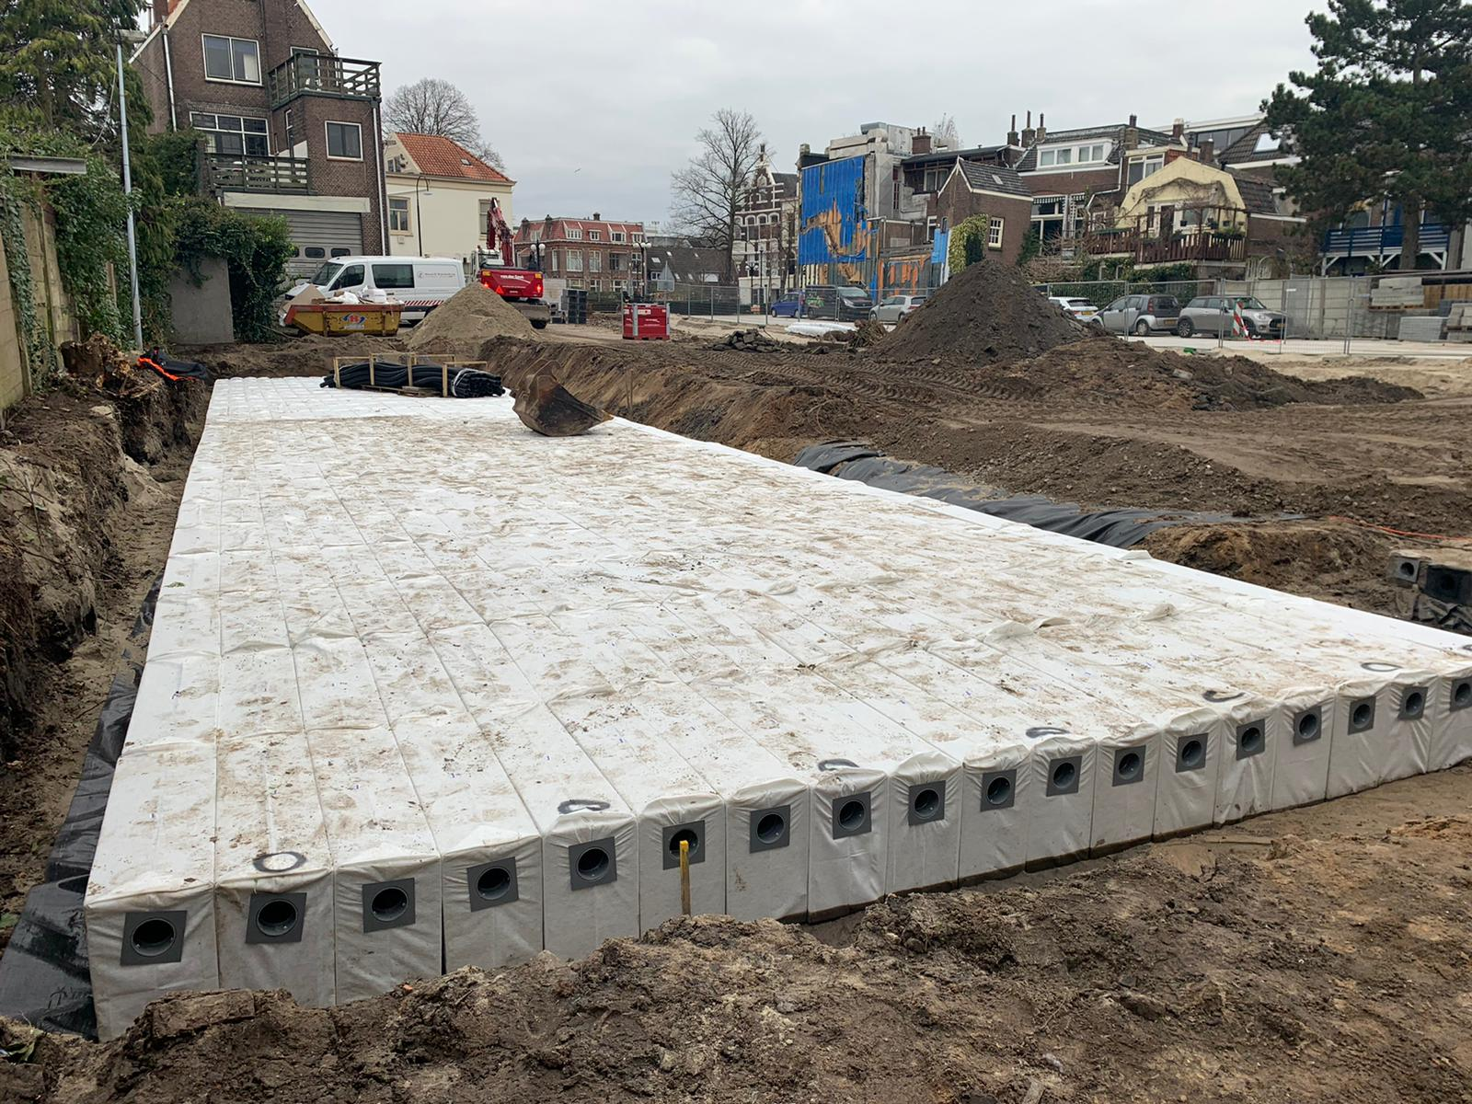
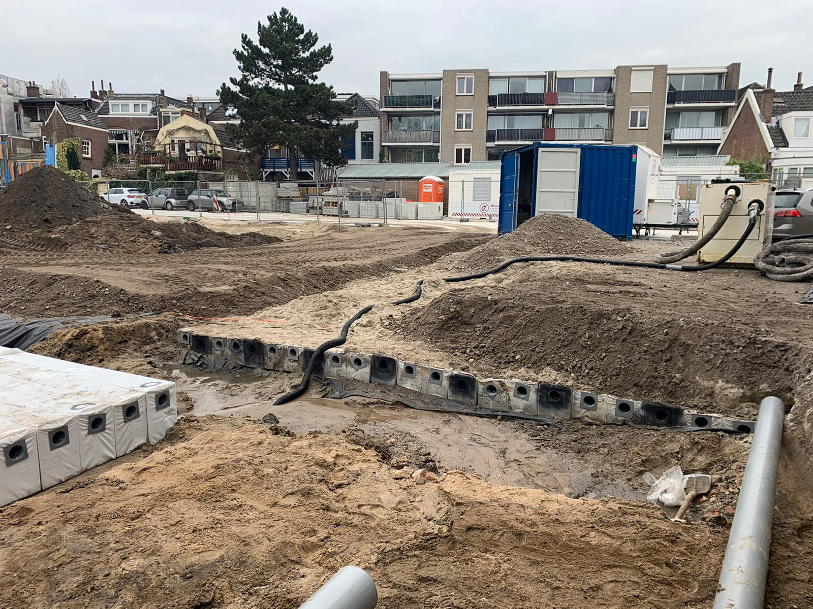
Very large Hydrorock infiltration system is fed from single Super Gully which collects roof runoff from many adjacent warehouses.
Super Gully connects to multiple Hydrorock Filter Gullies which connect to multiple Hydrorock modules side-by-side

Slide 7
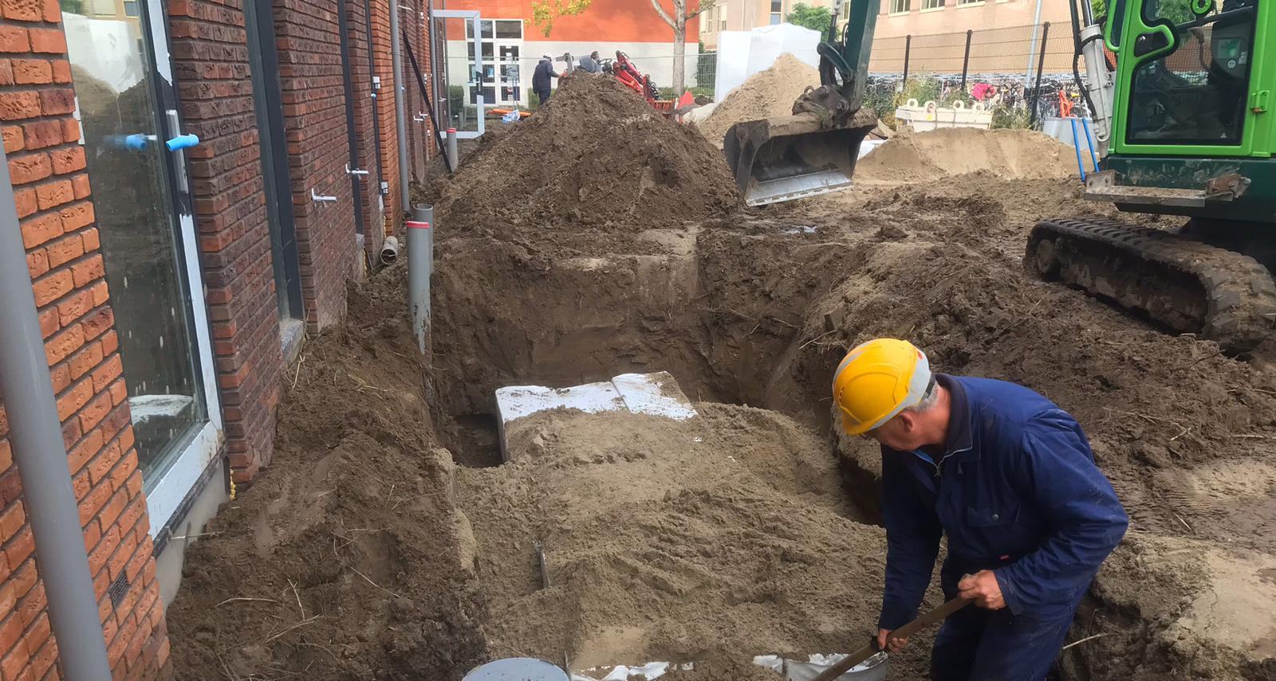
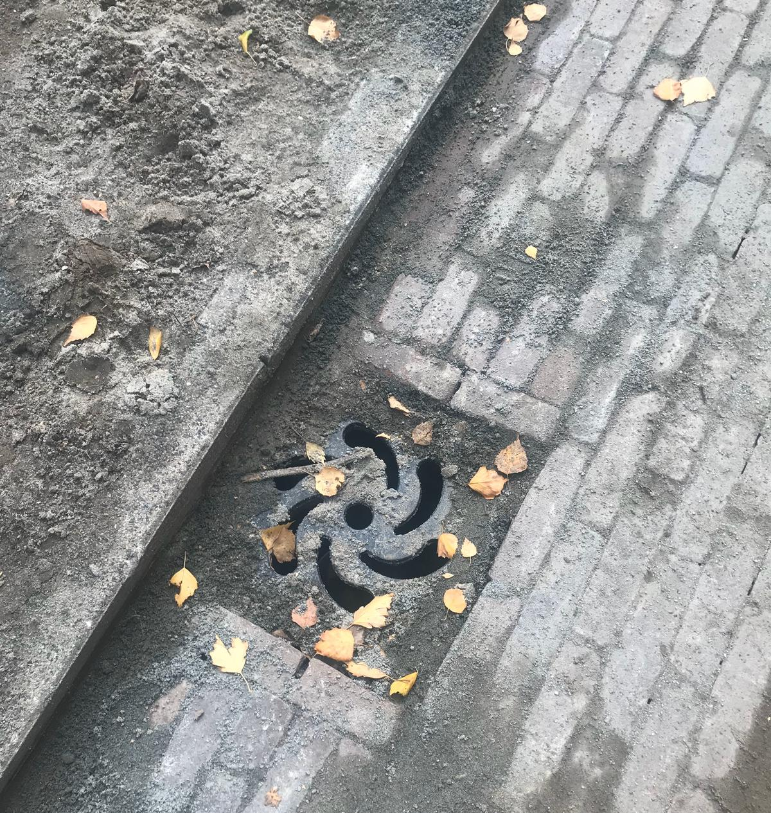
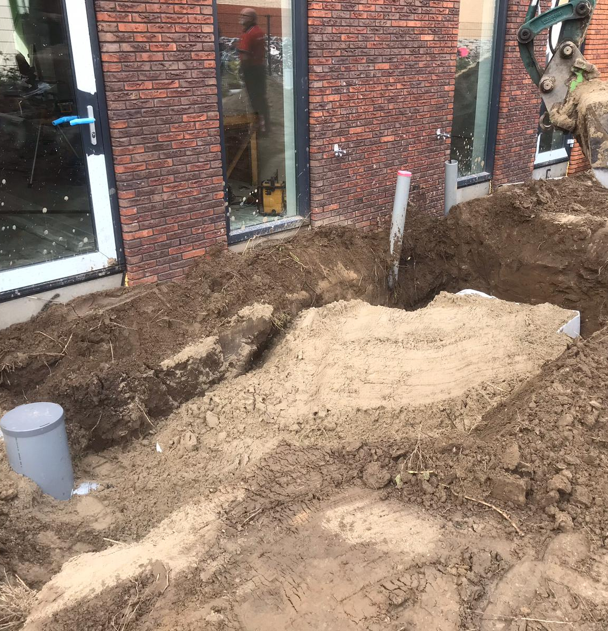
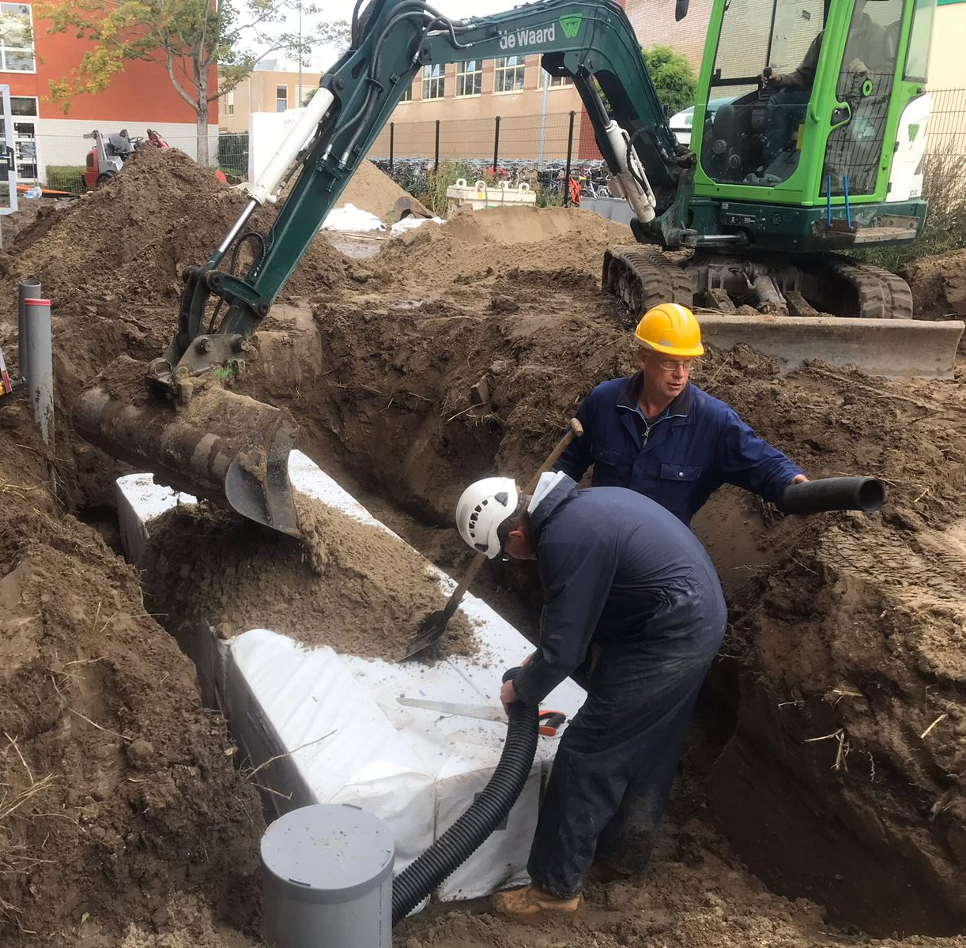
Filter Gully used for roof runoff subsurface fed system
Filter Gully installed in road for runoff surface fed system

Slide 8
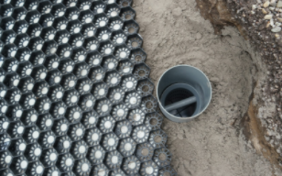
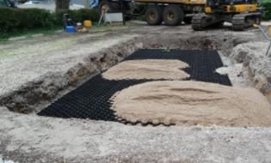
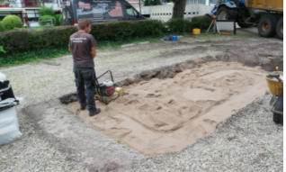
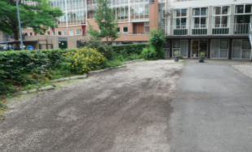
Hydrorock Filter Gully used for car park surface runoff fed system
Flooding of parking area in Amersfoort solved sustainably

