Slide 1
Hydrorock
Modules
Explained
www.hydrorock.com

Slide 2
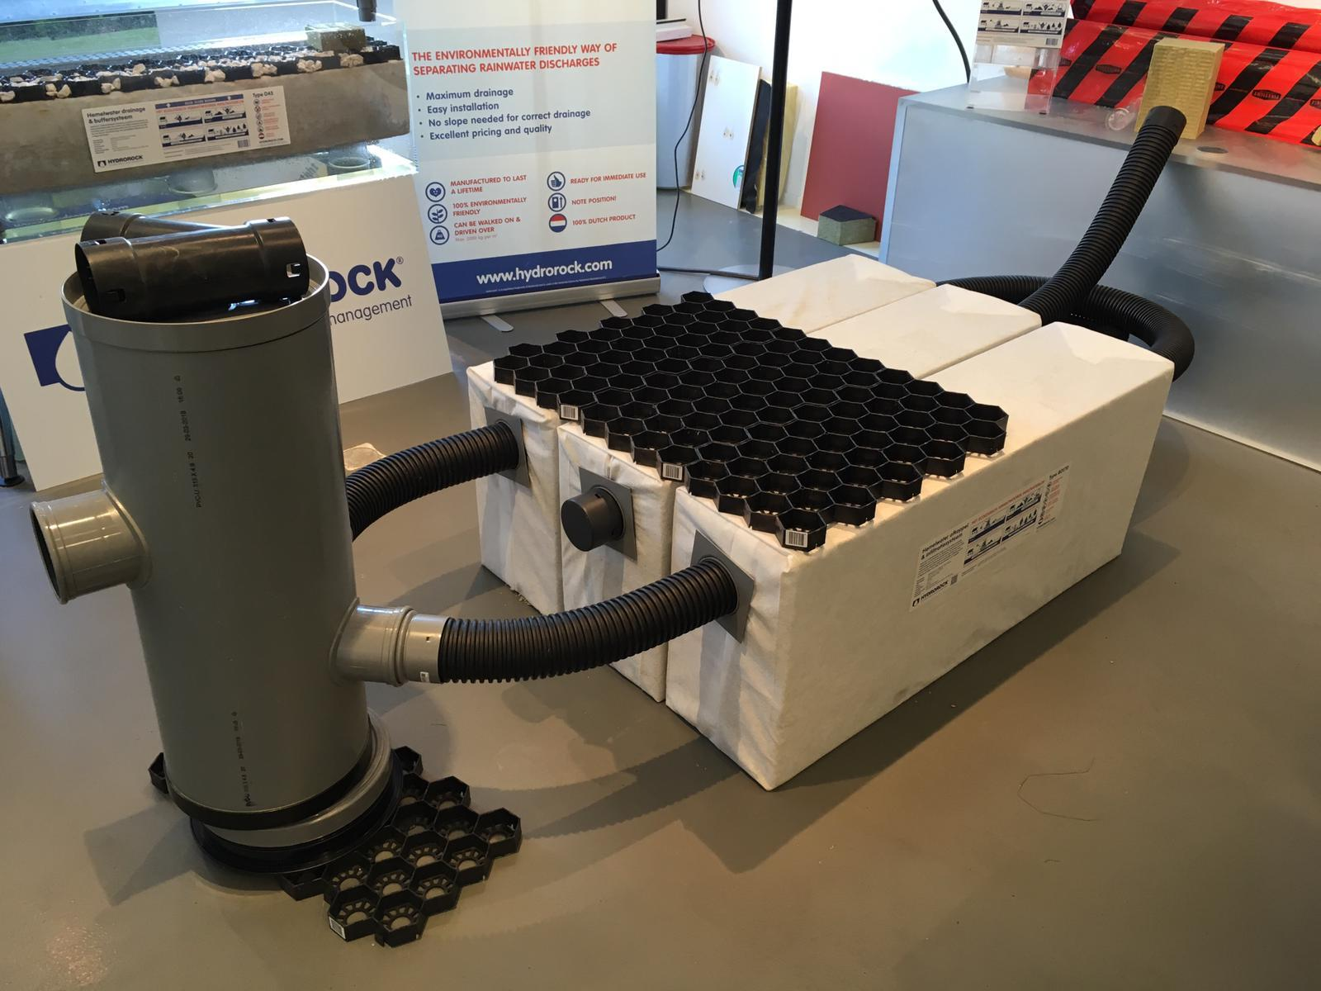

Slide 3
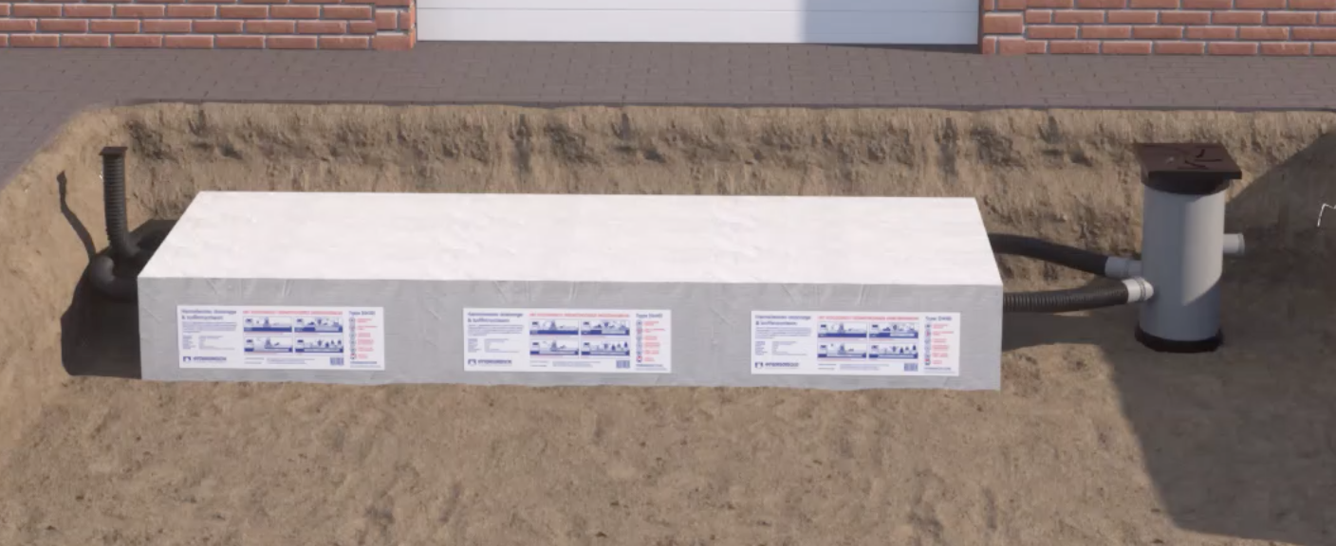

Slide 4
