Slide 1
Hydrorock
Southend Council
RETRO HOUSE

Slide 2
Hydrorock
Garden Module
Soakaway
www.hydrorock.com

Slide 3
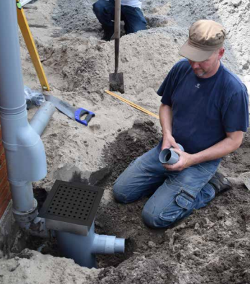
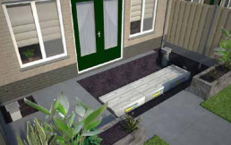
Hydrorock Retrofitted Downpipe Soakaway

Slide 4
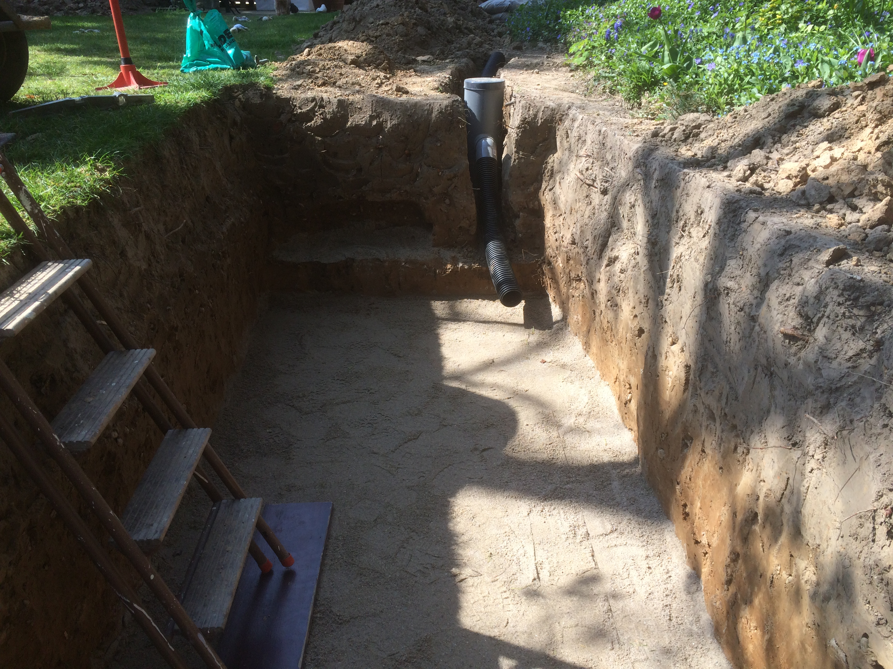
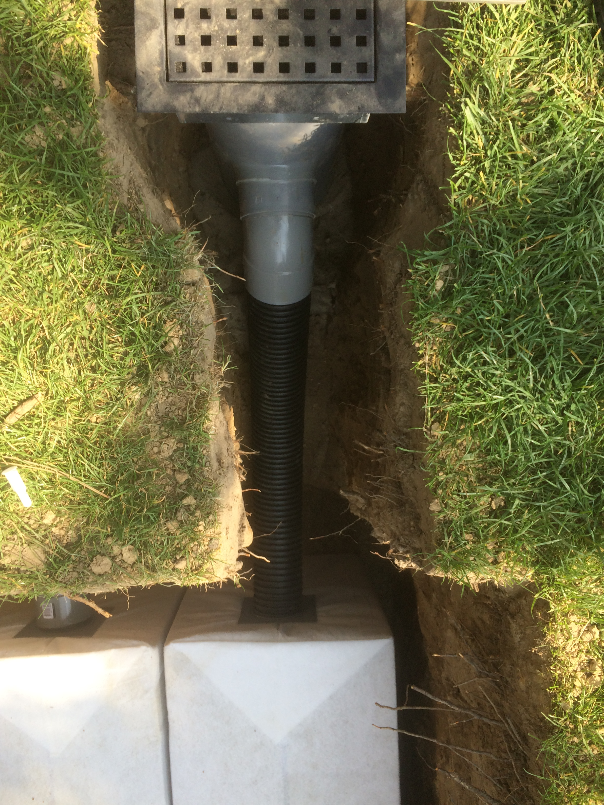
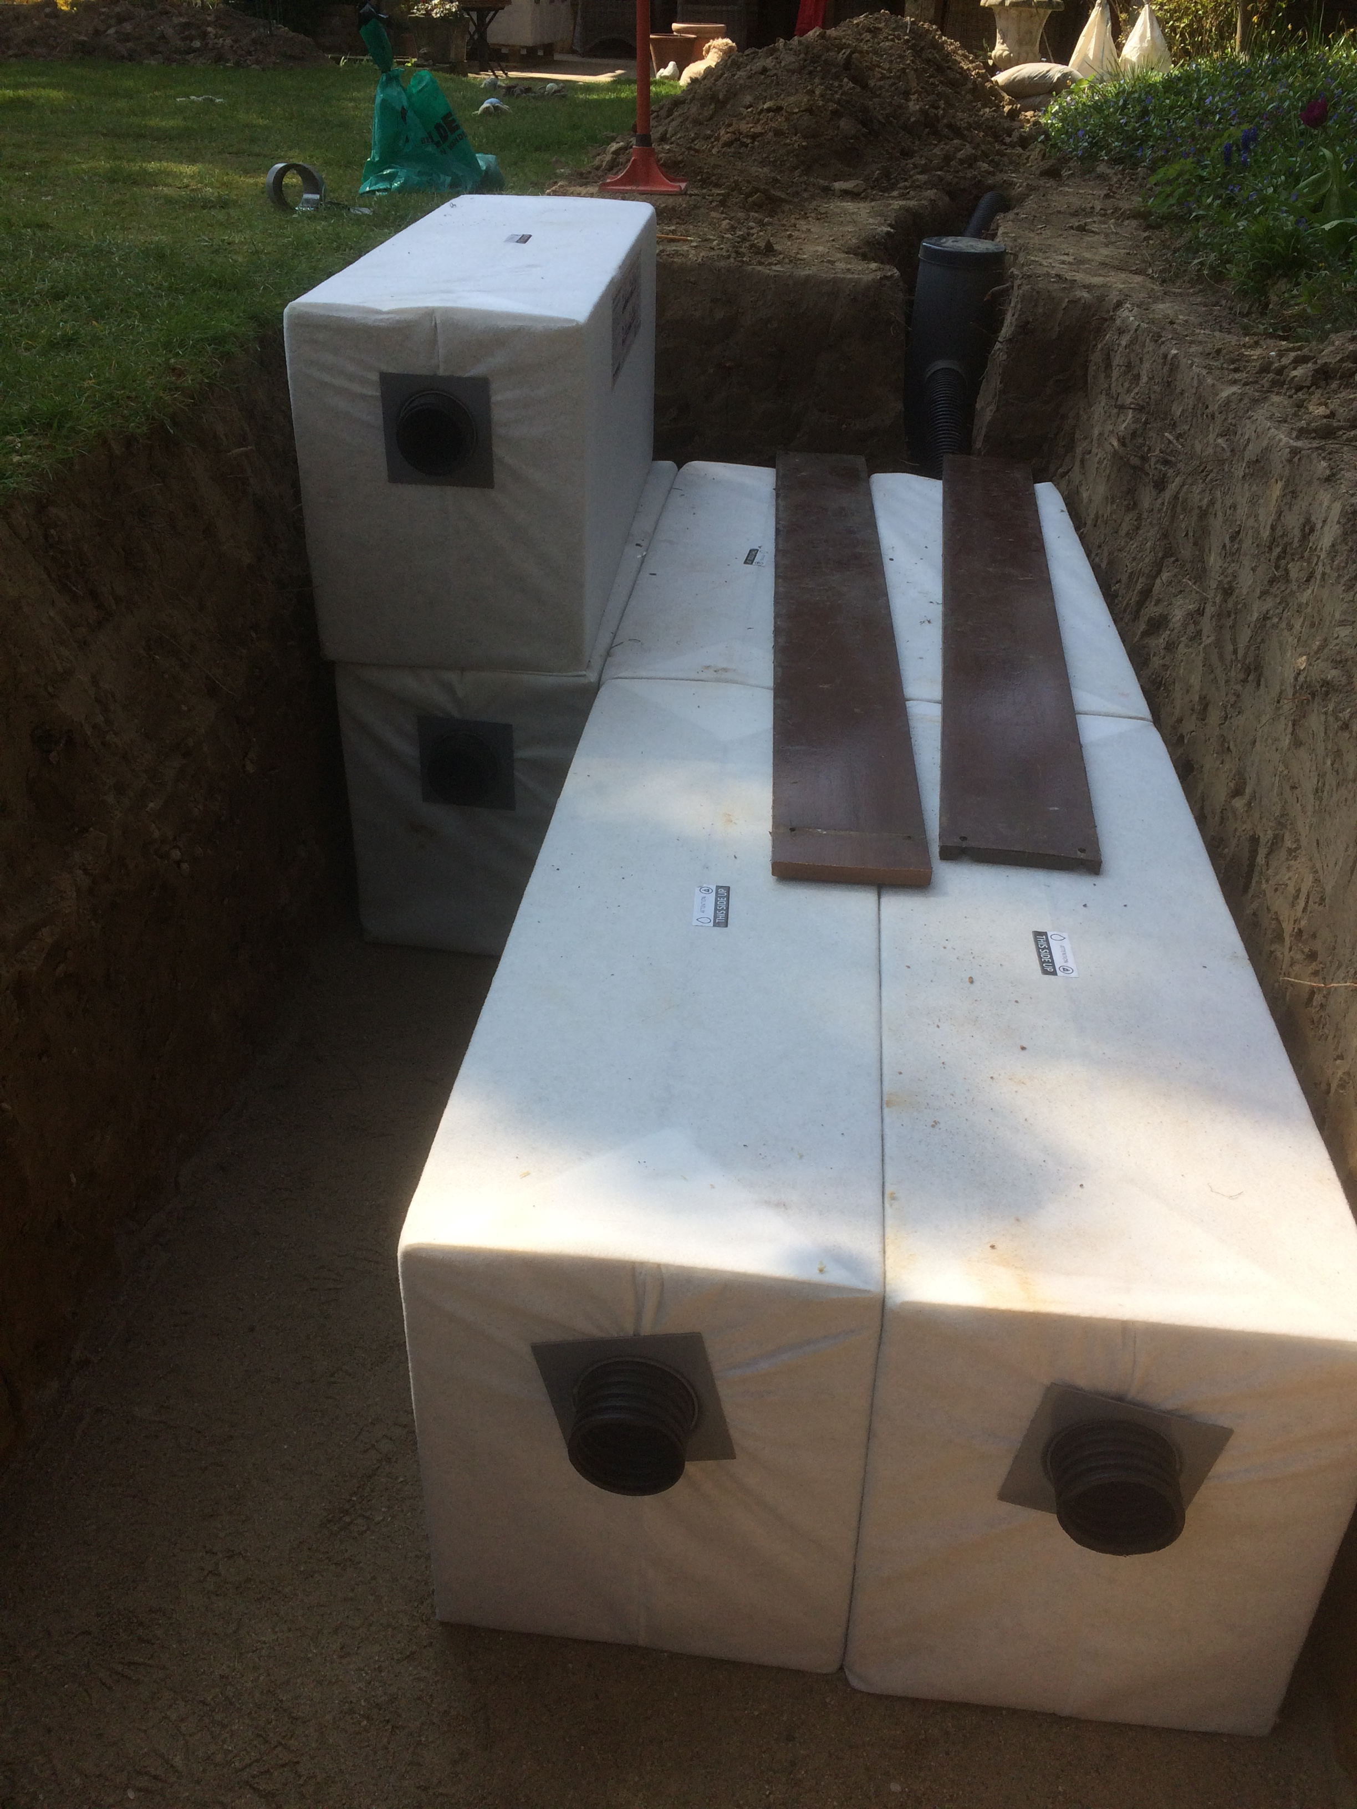
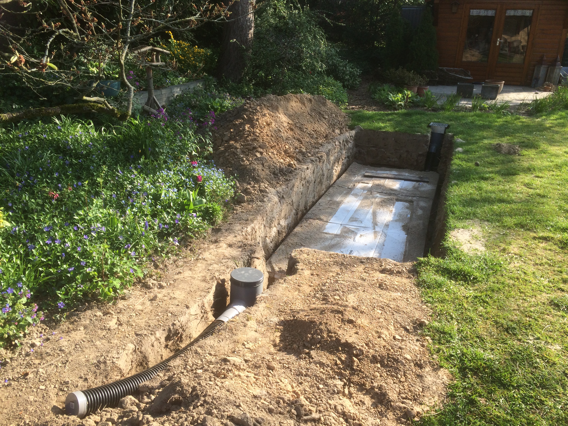
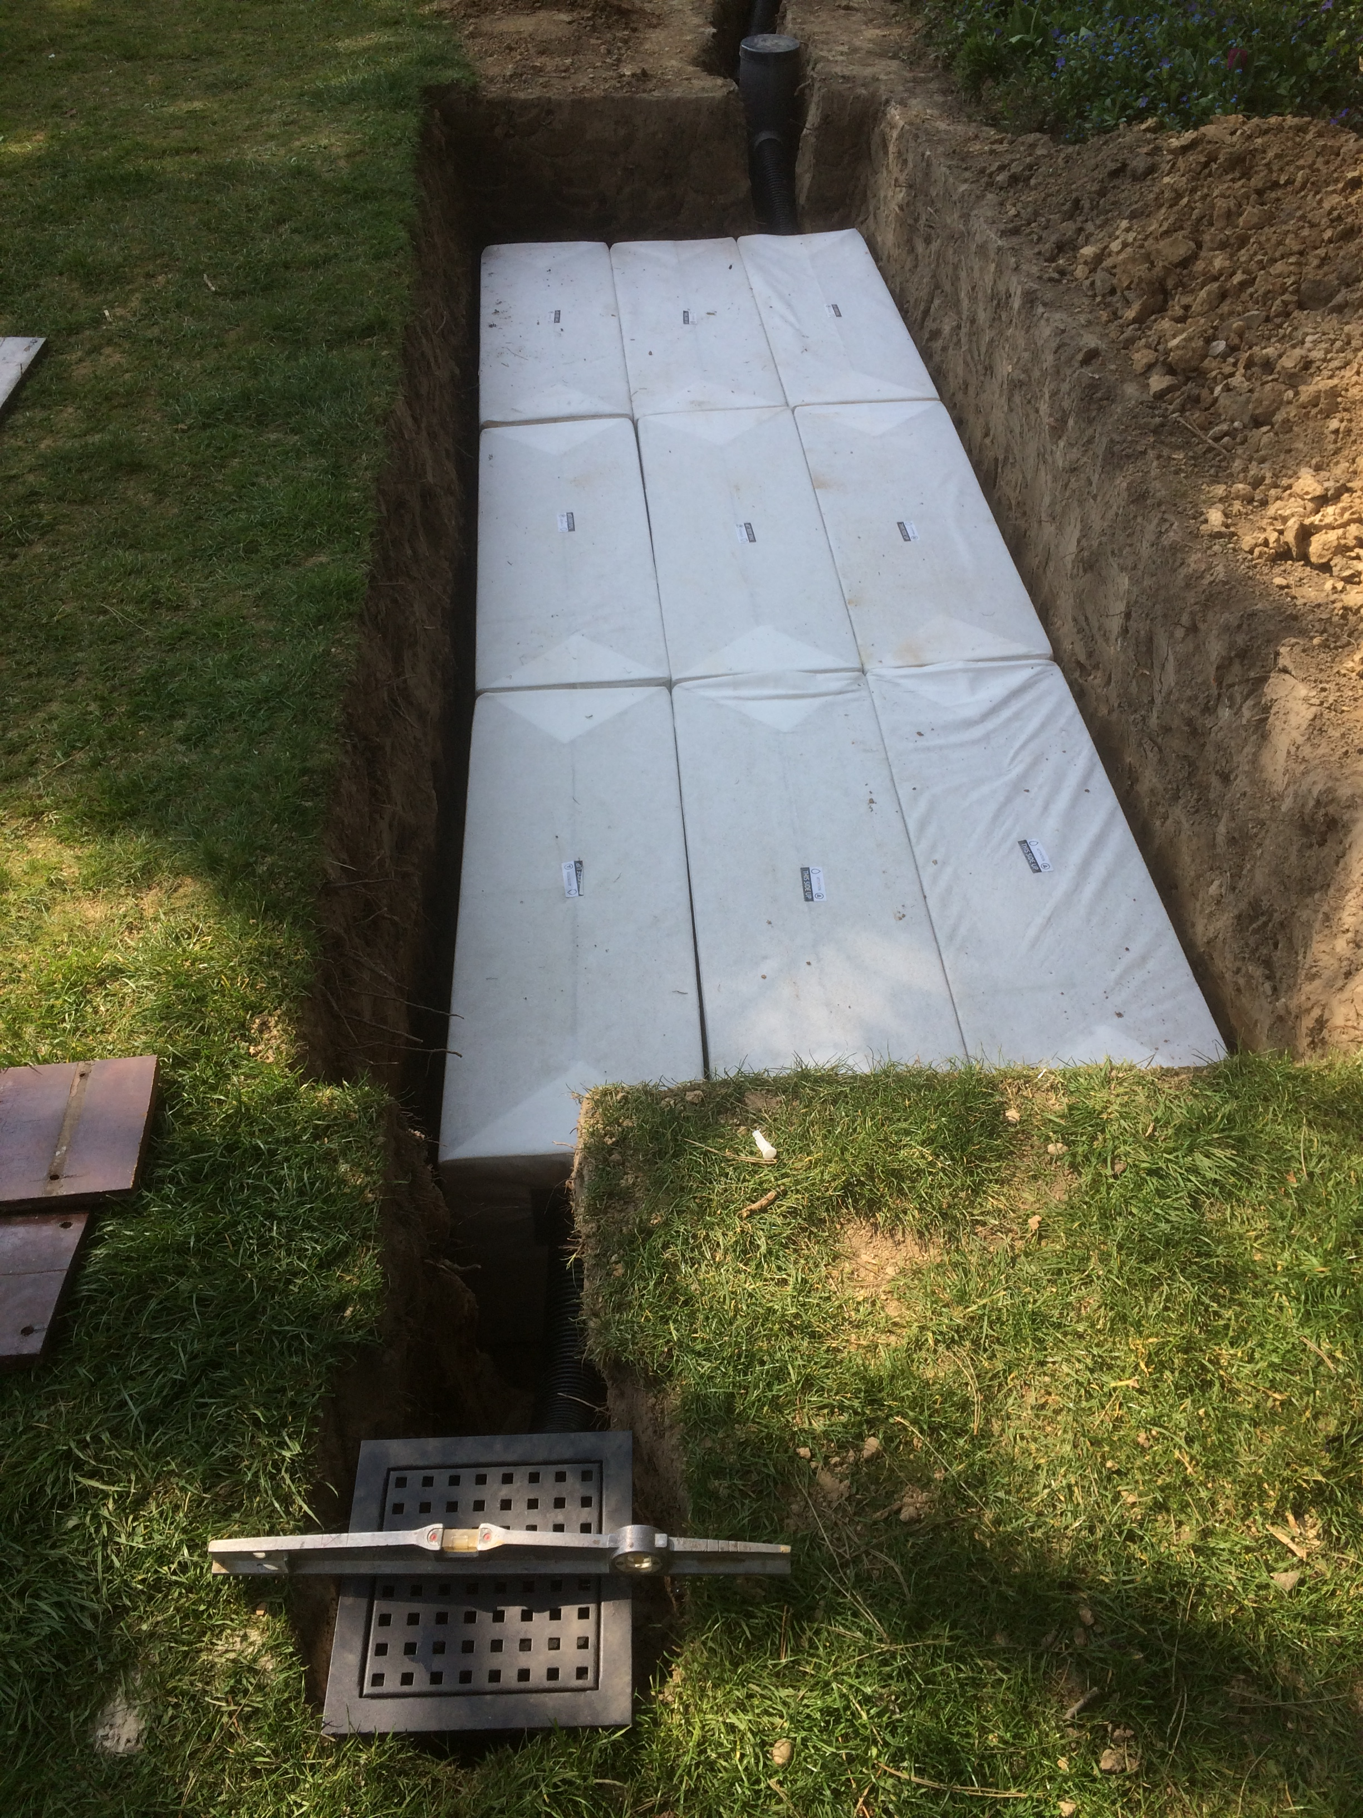
Hydrorock Garden Module Soakaway

Slide 5
Hydrorock
Patios
www.hydrorock.com
Gardenlux Online Brochure
https://www.jonksierbestrating.nl/bestanden/artikelen/8/1468_gardenlux-hydroblob-brochure.pdf?1566821082=

Slide 6
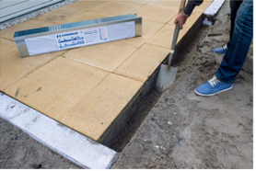
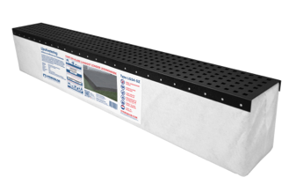
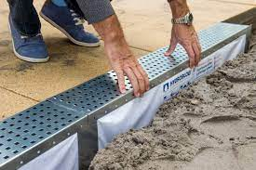
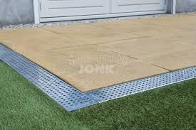
Hydrorock Linear Infiltration Units
Stainless Steel or Graphite Black
1200mm L x 150mm W x 200mm H (includes Block)
Comes with Hydrorock Aquifer Block 34L capacity

Slide 7
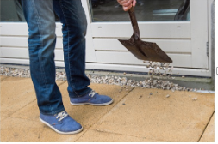
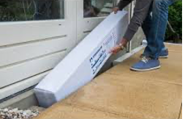
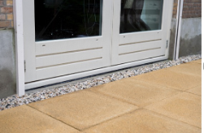
Hydrorock Aquifer Blocks
Installed around patio directly under gravel and immediately abutting house wall

Slide 8
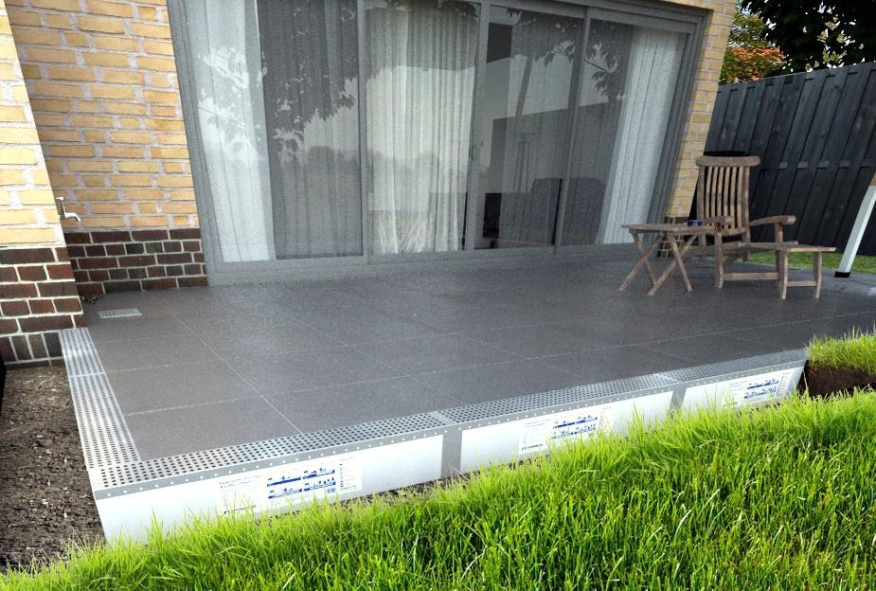
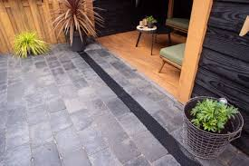

Slide 9
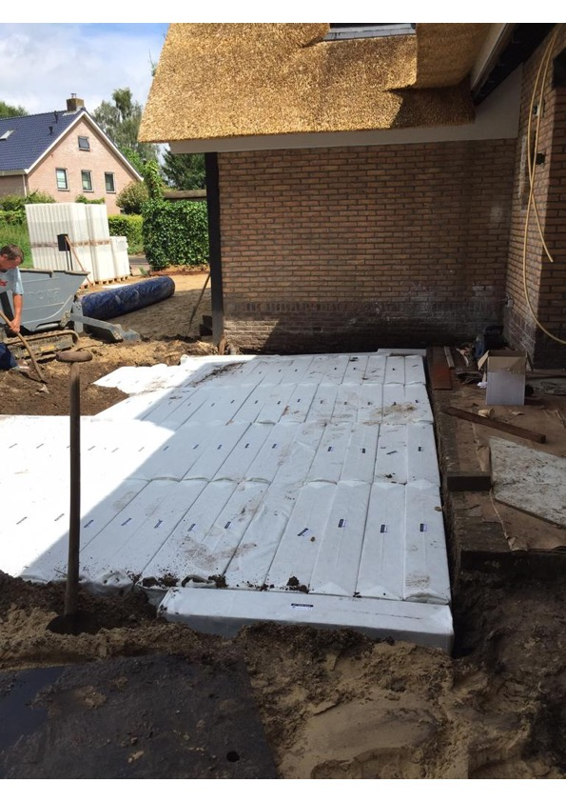
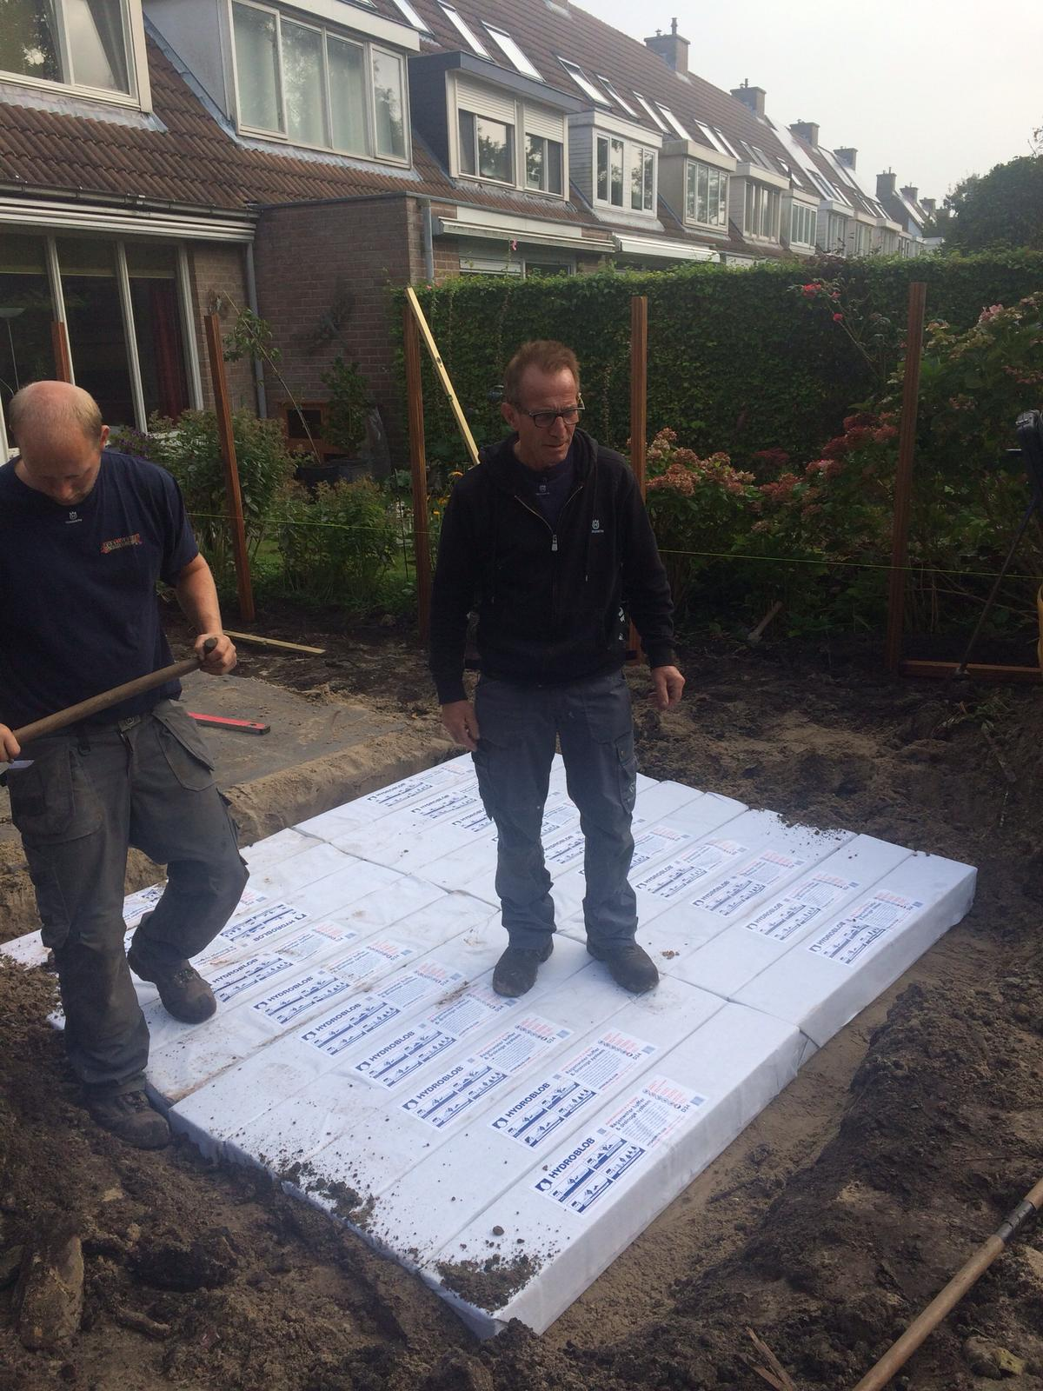
Installed directly abutting patios
Installed directly under patios & pathways

Slide 10
Hydrorock
Infiltration Pit Grate
www.hydrorock.com
Gardenlux Online Brochure
https://www.jonksierbestrating.nl/bestanden/artikelen/8/1468_gardenlux-hydroblob-brochure.pdf?1566821082=

Slide 11
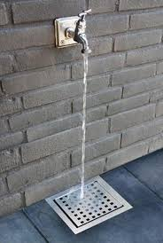
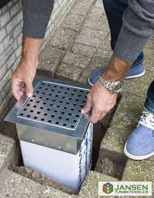
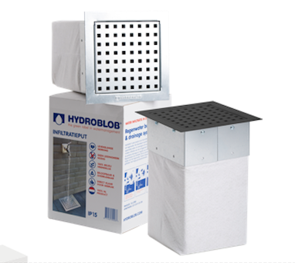
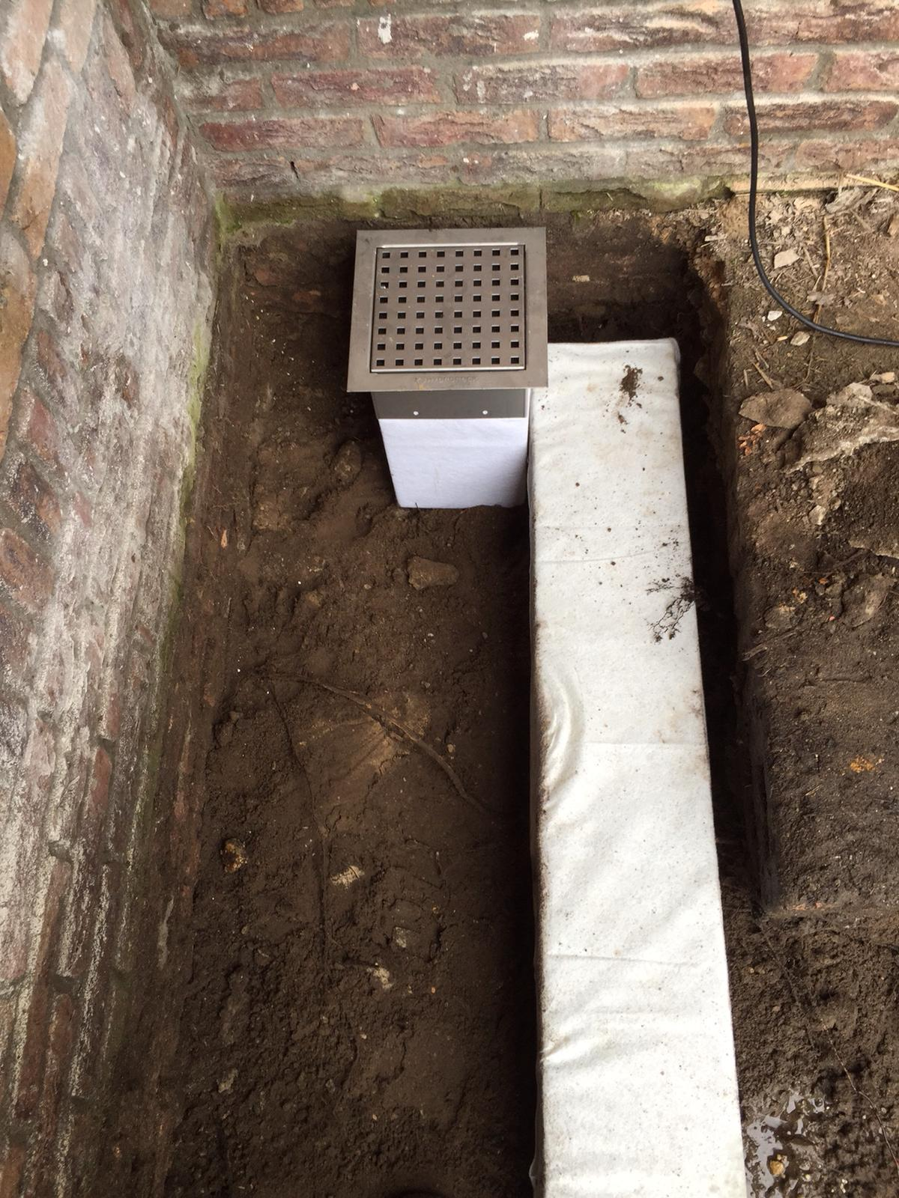
Hydrorock Infiltration Pit Grate
Additional Hydrorock Aquifer Blocks abutted together to increase Buffering storage capacity
Stainless Steel or Graphite Black
Slimline Linear Gutter / Buffer
250mm L x 250mm W x 350mm H (includes Block)
Comes with Hydrorock Aquifer Block 15L capacity

Slide 12
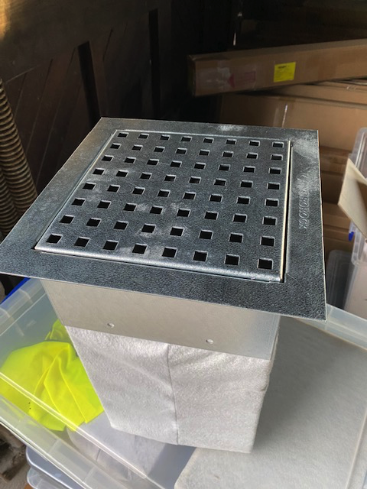
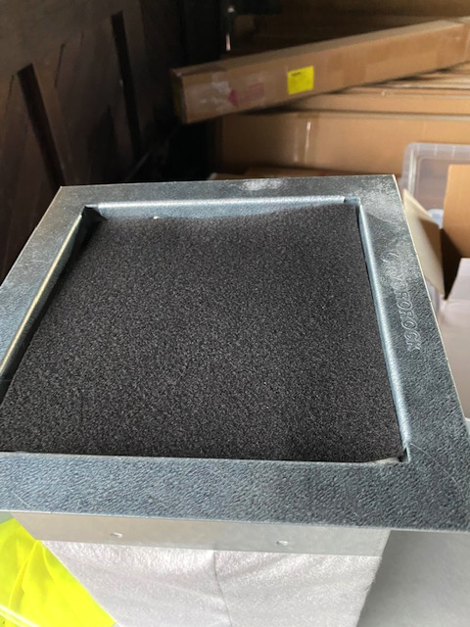
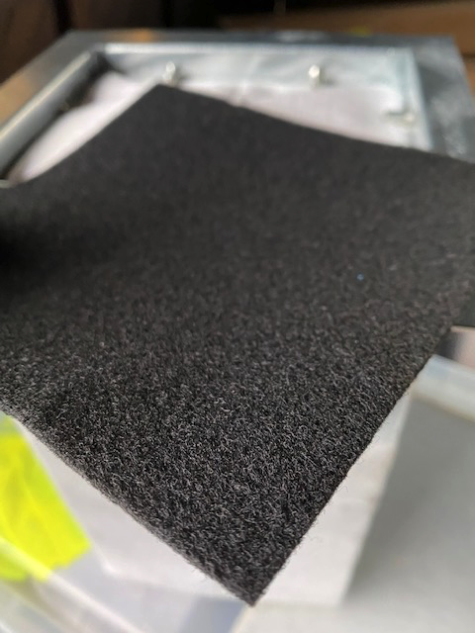
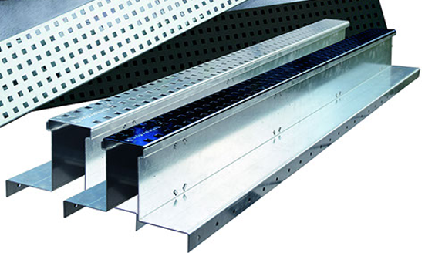
Simple, Fast Cleaning of Filter Mat
Matted fibre filter matter prevents ingress of silt etc – Hydrorock Blocks are further protected with geotextile wrapping
If matted fibre filter ever needs to be cleaned it can be removed, shaken-outand replaced in moments – as seen / described in photos
Metal insert lifted out for cleaning
Matted fibre enables water to readily flow into Blocks beneath but prevents silt and other debris reaching Block
Matted fibre lifted off top of Block and out of metal frame – shaken out and replaced

Slide 13
Hydrorock
Permeable Paving Grills
www.hydrorock.com
Gardenlux Online Brochure
https://www.jonksierbestrating.nl/bestanden/artikelen/8/1468_gardenlux-hydroblob-brochure.pdf?1566821082=

Slide 14
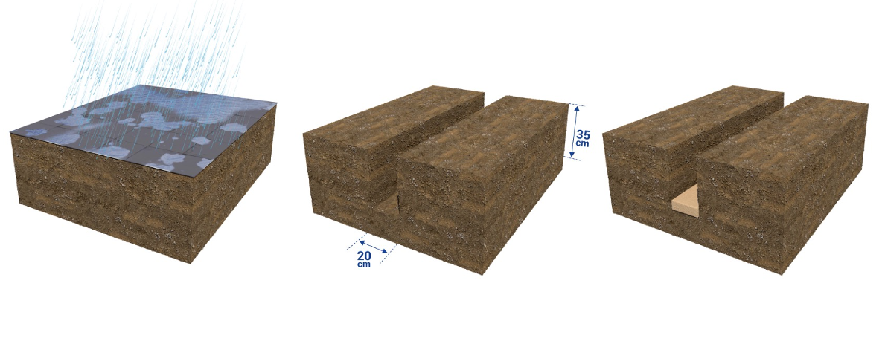
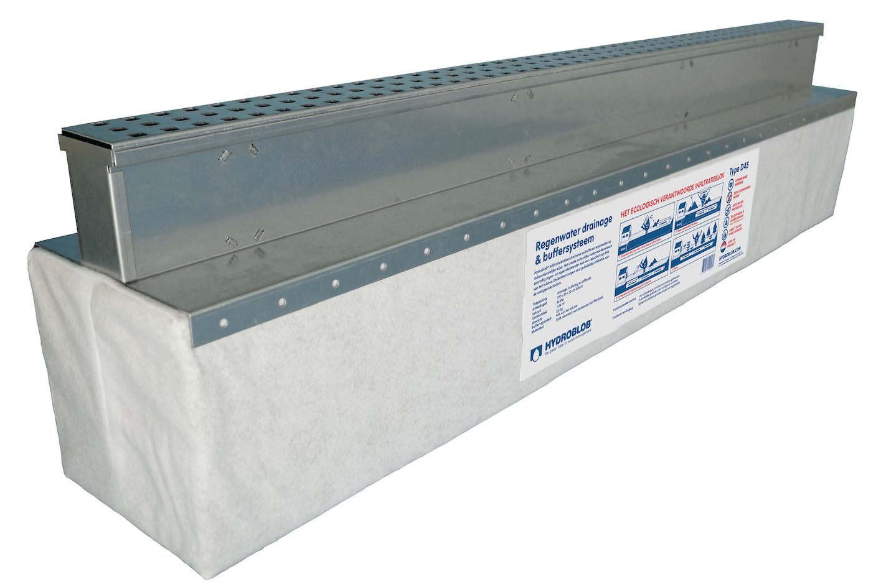
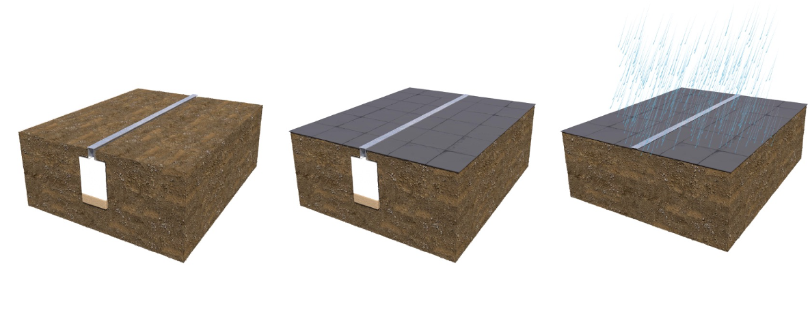
Hydrorock Slimline Channel Installation
Galvanised / Stainless Steel / Graphite
1200mm L x 300mm W x 100mm H
Gardenlux Online Brochure
https://www.jonksierbestrating.nl/bestanden/artikelen/8/1468_gardenlux-hydroblob-brochure.pdf?1566821082=

Slide 15
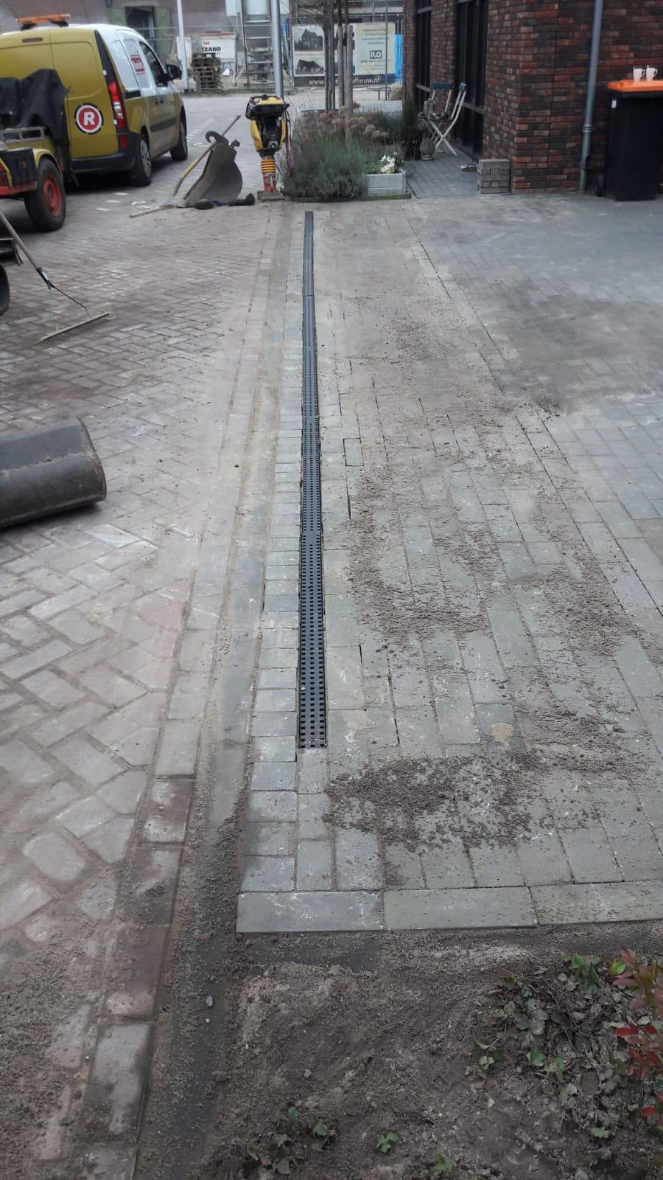
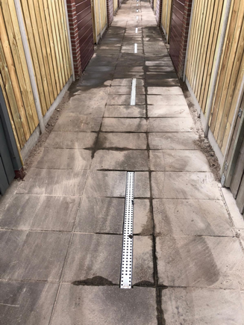
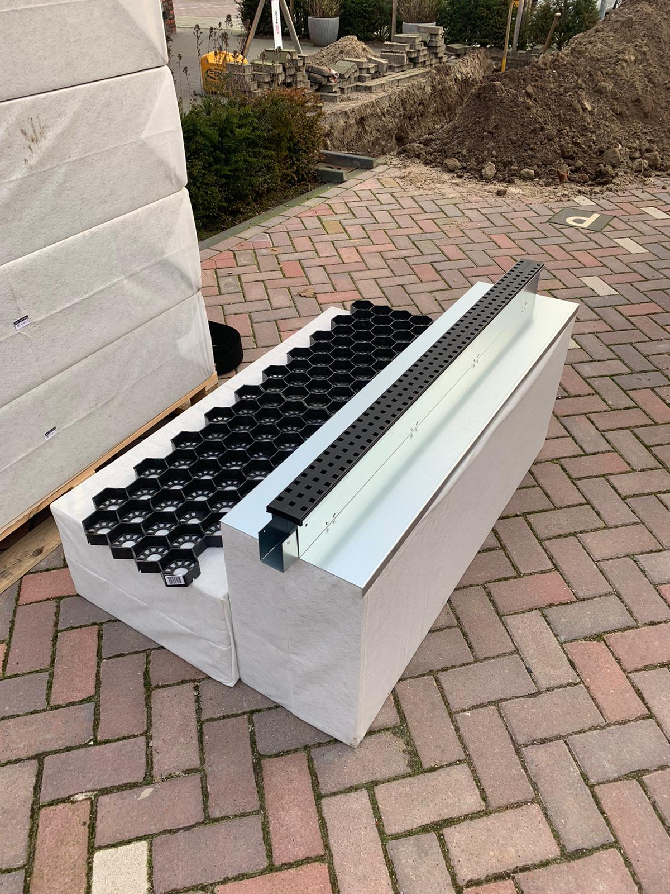
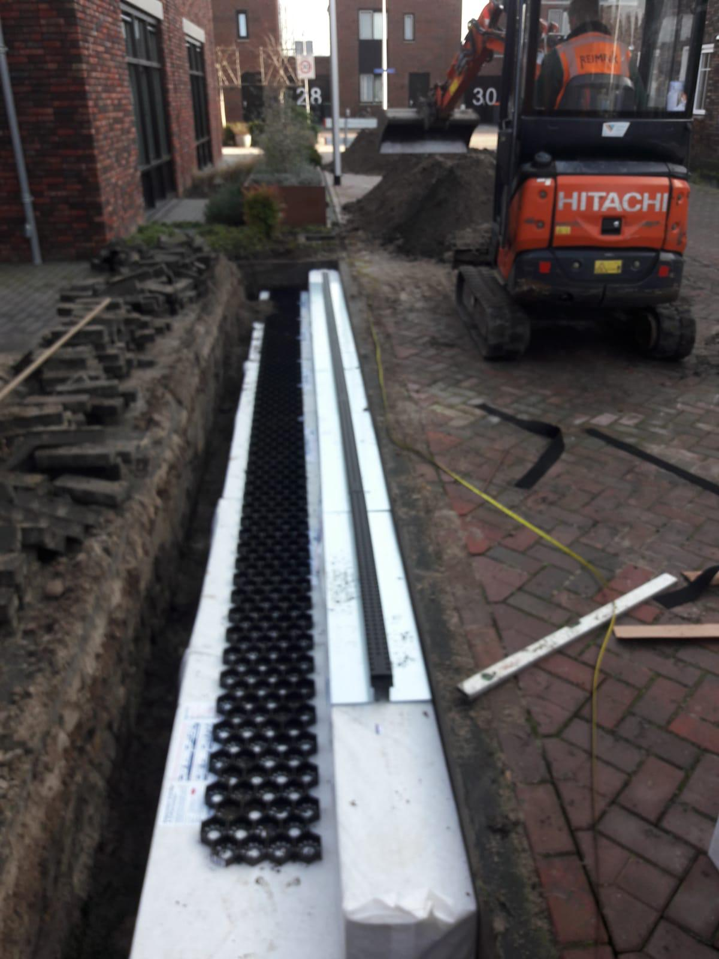
Hydrorock Slimline Channel Installation
Additional Hydrorock Aquifer Blocks abutted together to increase surface runoff Buffering storage capacity
Slimline Grills retrofitted beneath permeable paving to provide additional stormwater buffering and prevent flooding

Slide 16
Hydrorock
Driveway
Surface-fed
Soakaway
www.hydrorock.com

Slide 17
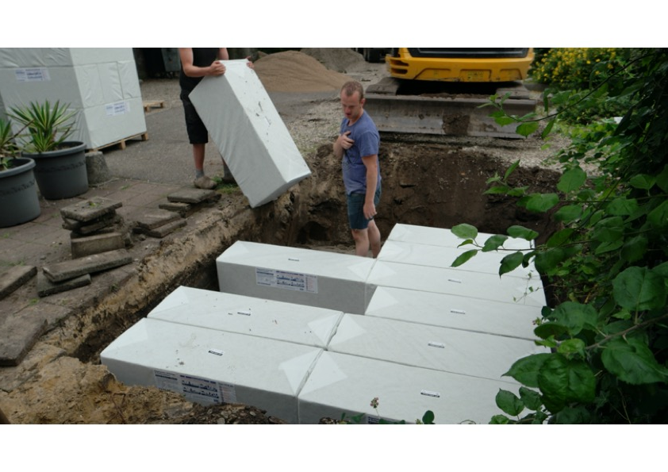
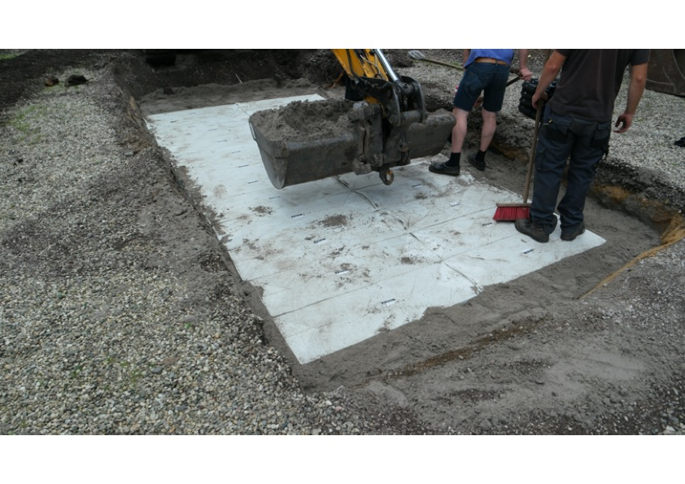
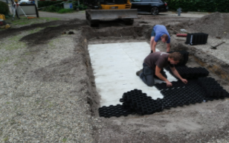
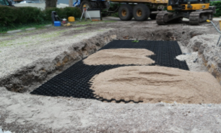
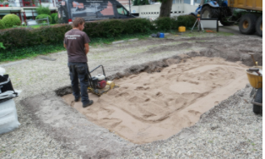

Slide 18
Hydrorock
Planters
www.hydrorock.com

Slide 19
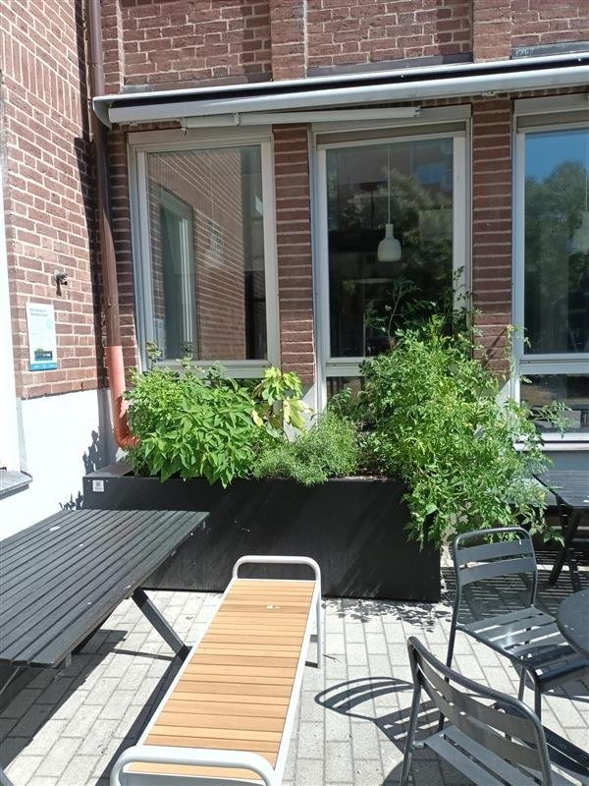
The Hydrorock Planter System provides wide versatility in use and unlimited flexibility in design configuration, installation and operation
The Hydrorock Planter System can be simply and easily installed:
in all types planters - professionally purpose-built or improvised DIY
in all sizes of Planters – using Hydrorock Blocks in varying numbers and sizes (water capacity)
in any configuration – irregular shaped planters; piped and unpiped systems
for a wide variety of uses – disconnecting buildings from sewers; harvesting rainwater; slowing runoff; utilising grey water; greening urban areas; irrigation
for a wide variety of purposes – flowerbeds; tree pits; growing vegetables
Public building in Norway

Slide 20
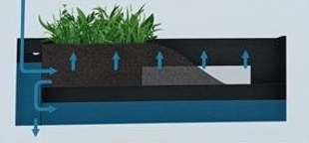
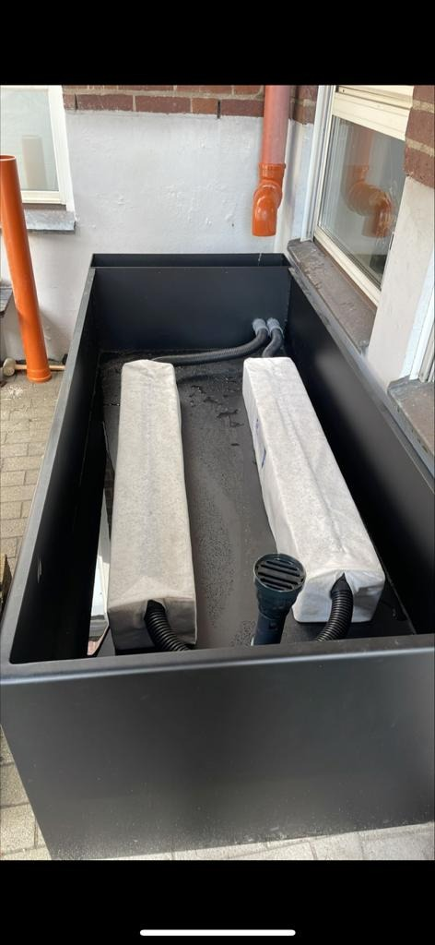
Professionally purpose-built Hydrorock Planter system used in Scandinavia
Water roots draw water up through soil from Hydrorock Blocks
Hydrorock Block filling point in arid periods to maintain plant health
Water from downpipe enters top section of planter cistern
Water from top section of planter cistern pipes into Hydrorock Blocks
Excess water in the system re-enters bottom section of Cistern
Excess water leaves Cistern via overflow pipe at controlled rate
Water moves up through Blocks via capillary action

Slide 21
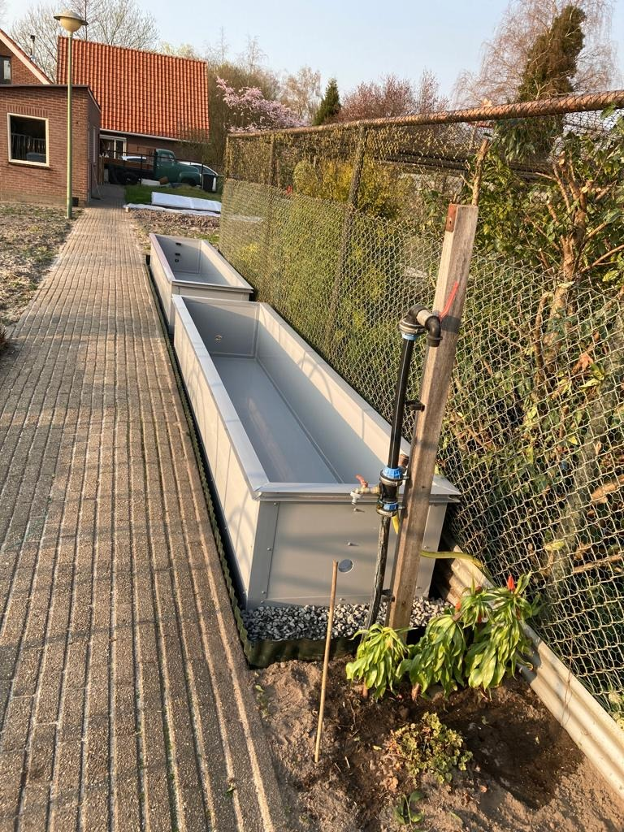
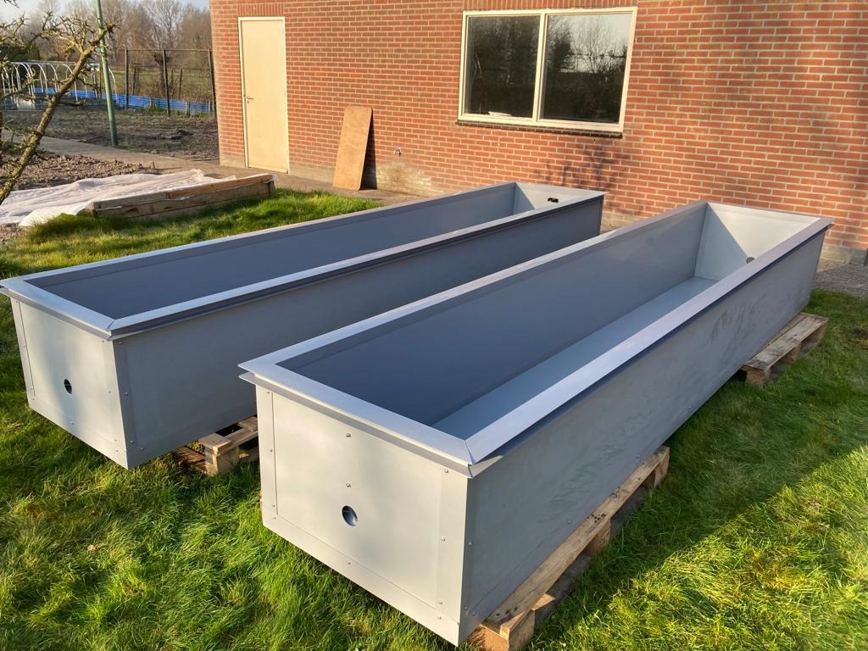
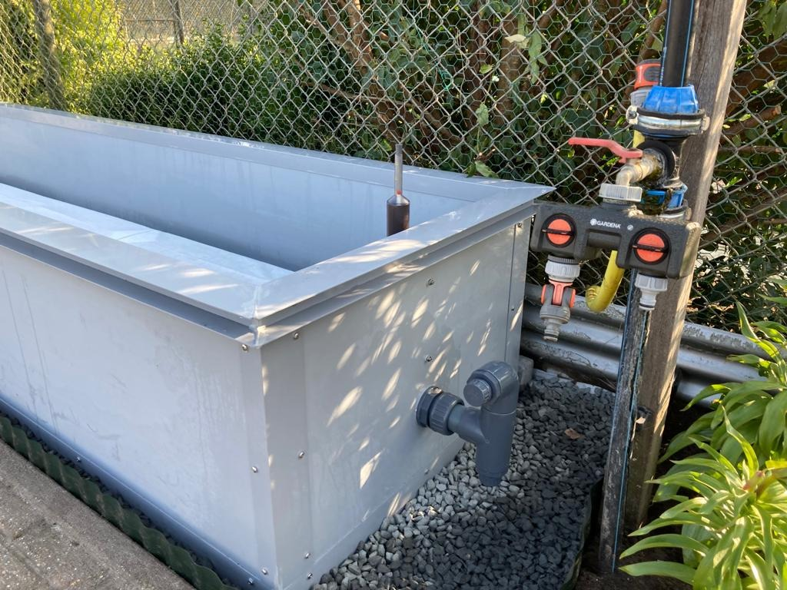
DIY vegetable Hydrorock Planter system during installation in Scandinavia
Repurposing animal water troughs – with water feed from pumped house grey-water tank
Private garden in Norway

Slide 22
Hydrorock
Flood Protection
www.hydrorock.com

Slide 23
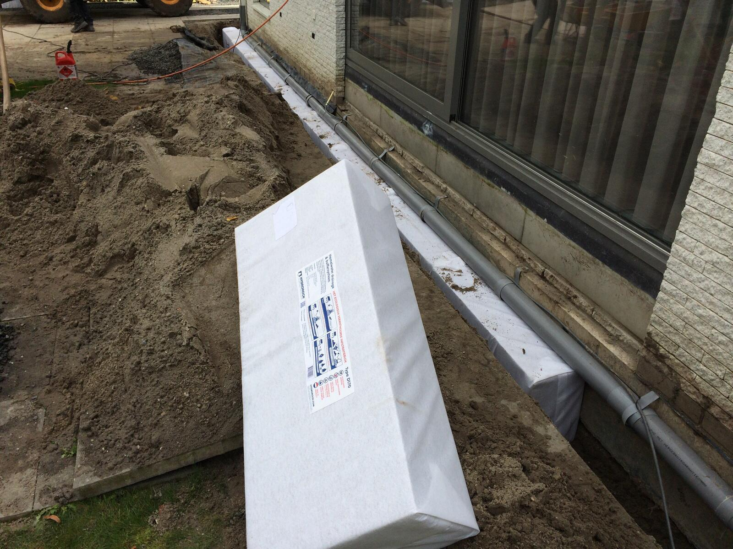
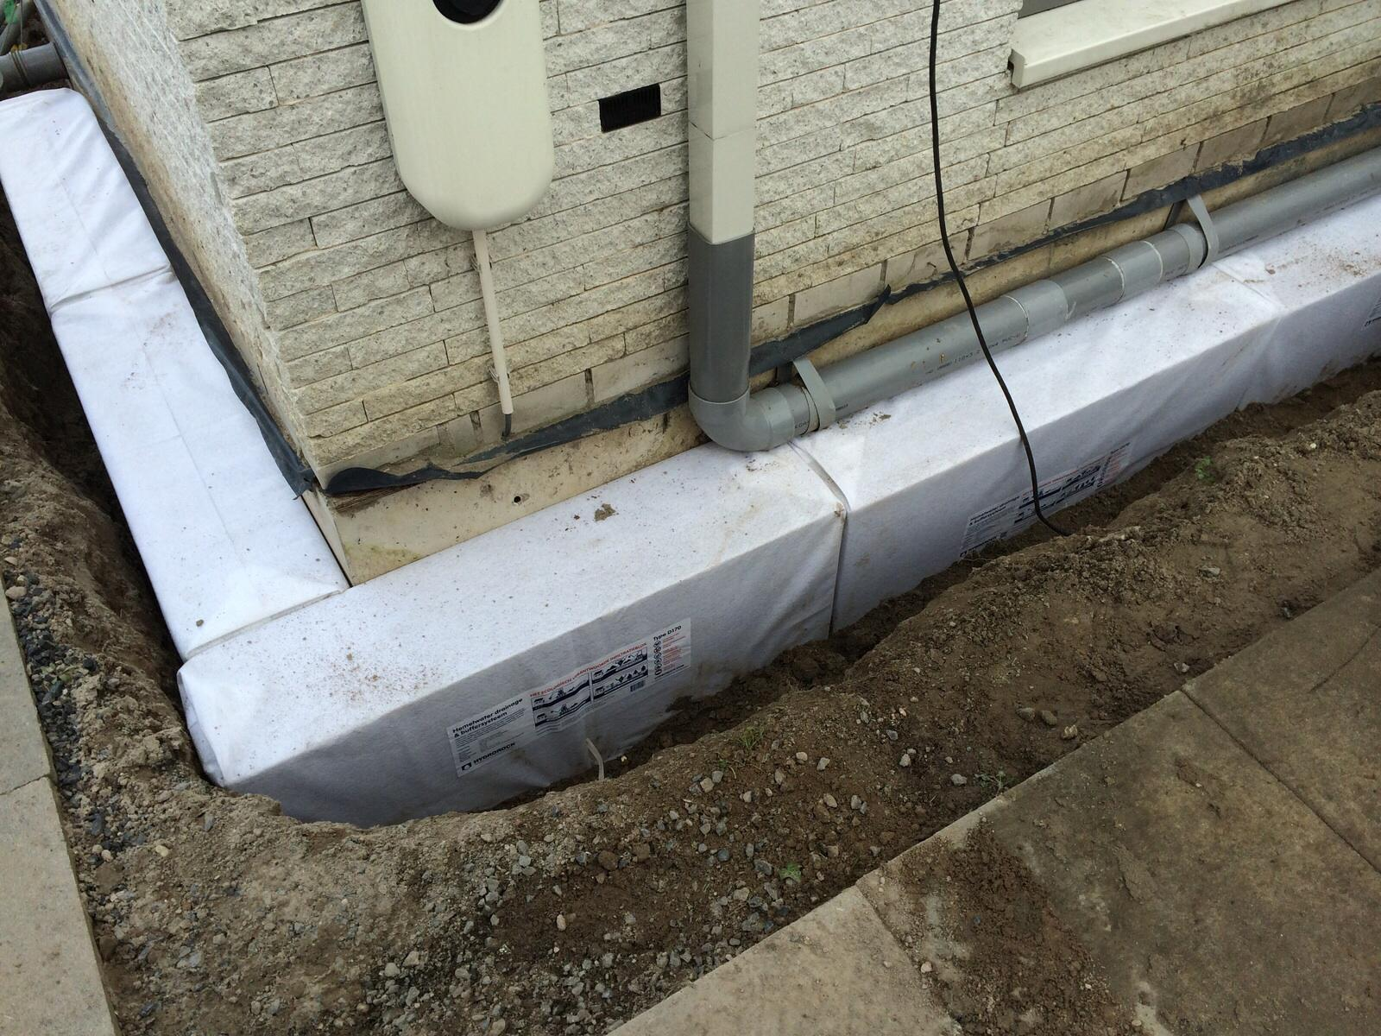
Hydrorock House Ring Protection

Slide 24
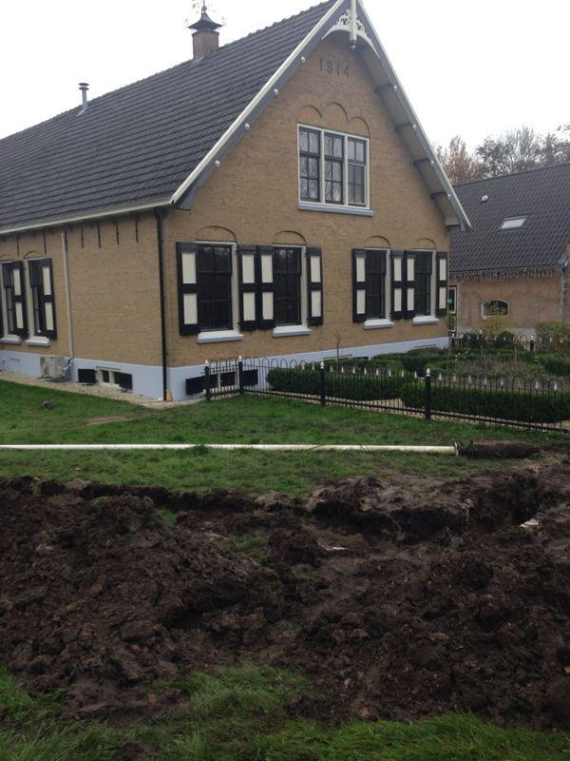
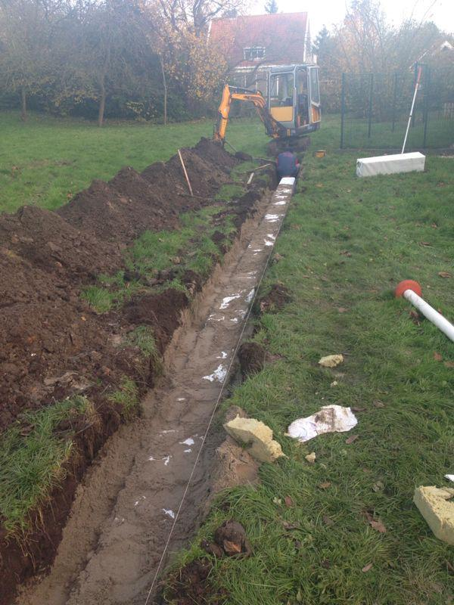
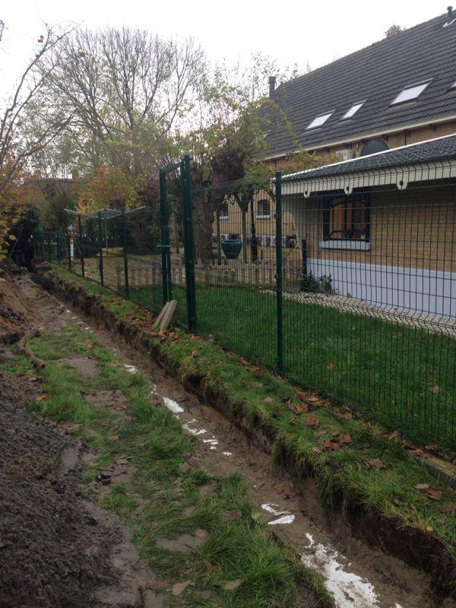
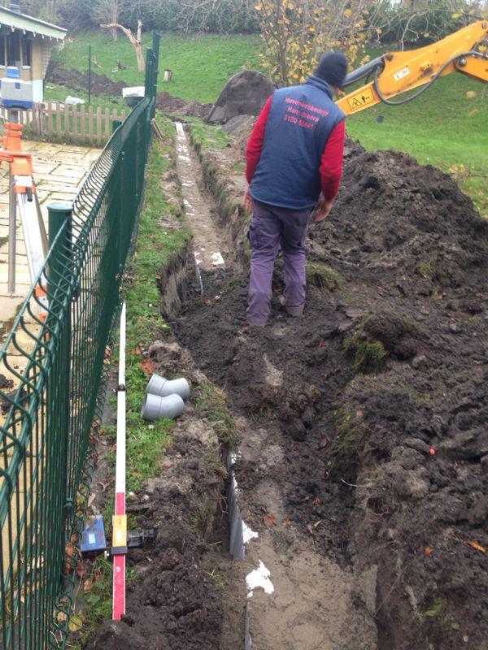
Hydrorock House Barrrier Protection

Slide 25
Gardenlux Online Brochure
https://www.jonksierbestrating.nl/bestanden/artikelen/8/1468_gardenlux-hydroblob-brochure.pdf?1566821082=

