Slide 2
This is Hydrorock
Basalt rock
Protective
geotextile membrane
Enormous capacity
to absorb water
Extremely light weight
Retains water
in a unique way
Between the fibres
Incredibly strong

Slide 4
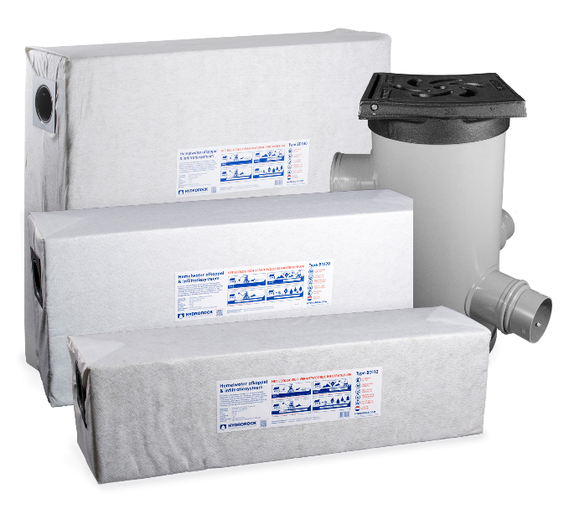
Properties
Easy draining and infiltration
Drains and stores rainwater efficiently
93% Capacity of its cubic volume
100% Natural material: Rockwool
Erosion-Resistant (Geotextile membrane)
Easy linkable blocks
Can be walked and driven over
(Heavy traffic up to 2.500 kg/m²)
Protects environment and property
One 360 liter block
holds 340 liter water!

Slide 5
Benifits
Low impact on earthwork
No slope needed for correct drainage
Easy to install
No plumbing required
Vegetation grows and flowers better on Hydrorock
No plastic (polypropylene) underground
Excellent price and performance
Ecologic alternative for infiltration crates,
drainpipes and gravel trenches
Buffering
Holding
Releasing

Slide 6
Applications
Disconnection of rainwater drains
Prevent flooding
Prevent desiccation

Slide 7
App|ications | Separation
Rainwater separation and infiltration system
With built-in perforated pipes, Hydrorock® blocks can be easily connected to rainwater discharges for sustainable local buffering and infiltration into the soil. This prevents flooding since excess water is effectively absorbed. As soon as the surrounding soil needs it, Hydrorock® blocks gradually releases the water. A connection to a rainwater or dry weather discharge system is unnecessary and impossible.

Slide 8
Applications | Flooding
Flood prevention
Hydrorock® infiltrationblocks are extremely suitable for draining and infiltrating excess rainwater on pavements, in gardens, around buildings.
Prevents flooding around the house
Ideal for thatched roofs (no gutter)
Very suitable for road construction

Slide 9
Applications | Desiccation
Prevent desiccation
Hydrorock® infiltration blocks are excelent for use in dry areas where water is scarcer or more precious. Especially if the soil needs to stay moist longer for growth and flowering.

Slide 10
Applications | Innovation
Innovation: irrigation
Hydrorock® holds water. This also makes it suitable for irrigation purposes. In collaboration with the University of Wageningen irrigation options have been developed in Dubai. Results where very positive regarding to efficient water use in date and fig production in the desert.

Slide 11
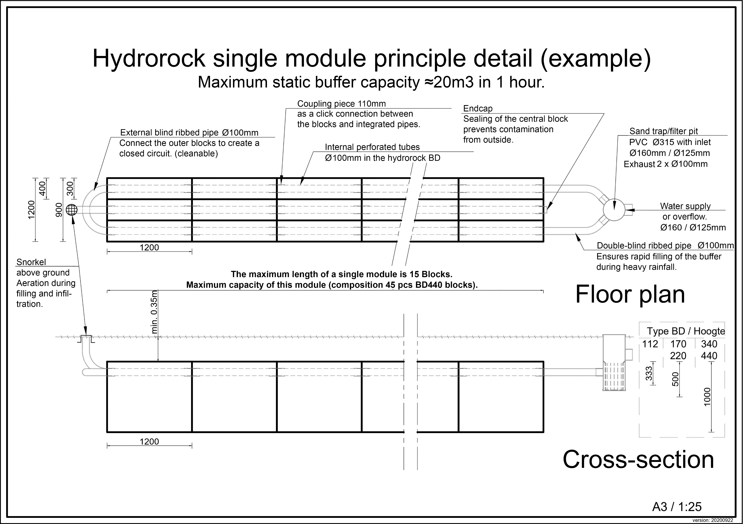
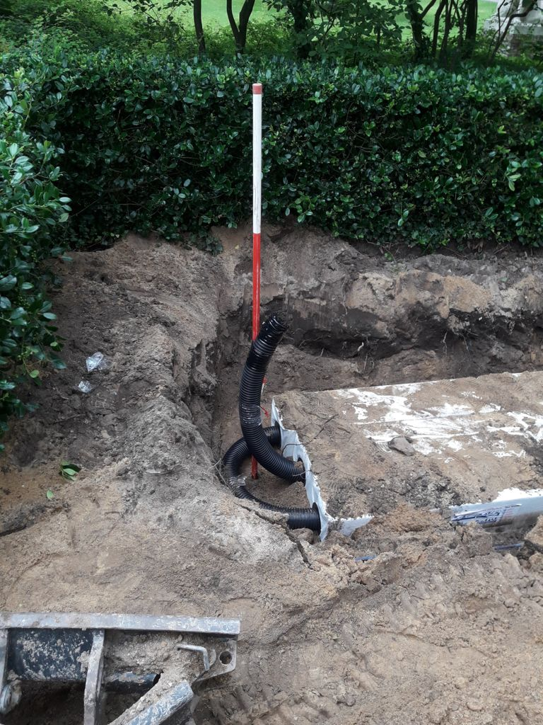
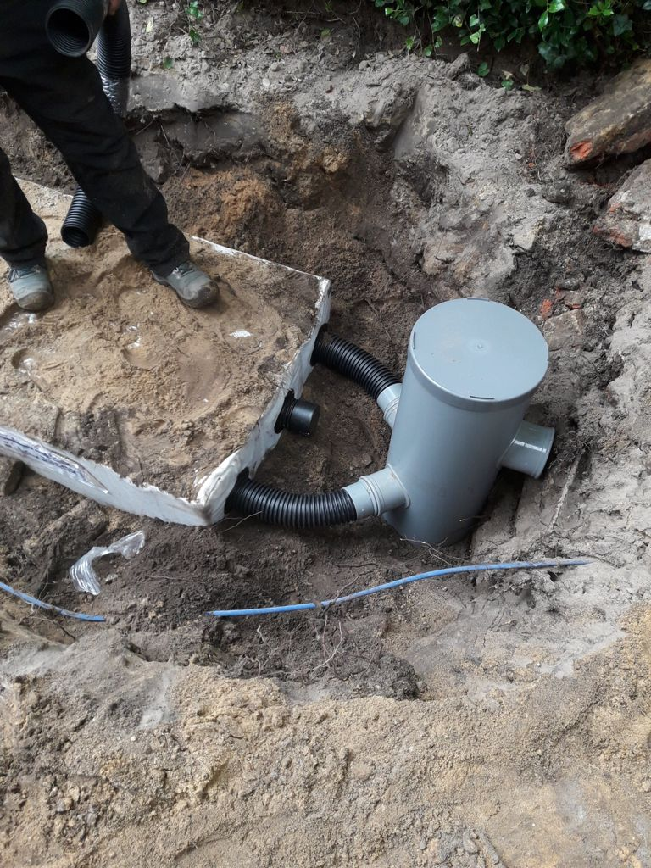
Hydrorock single module principle detail

Slide 12
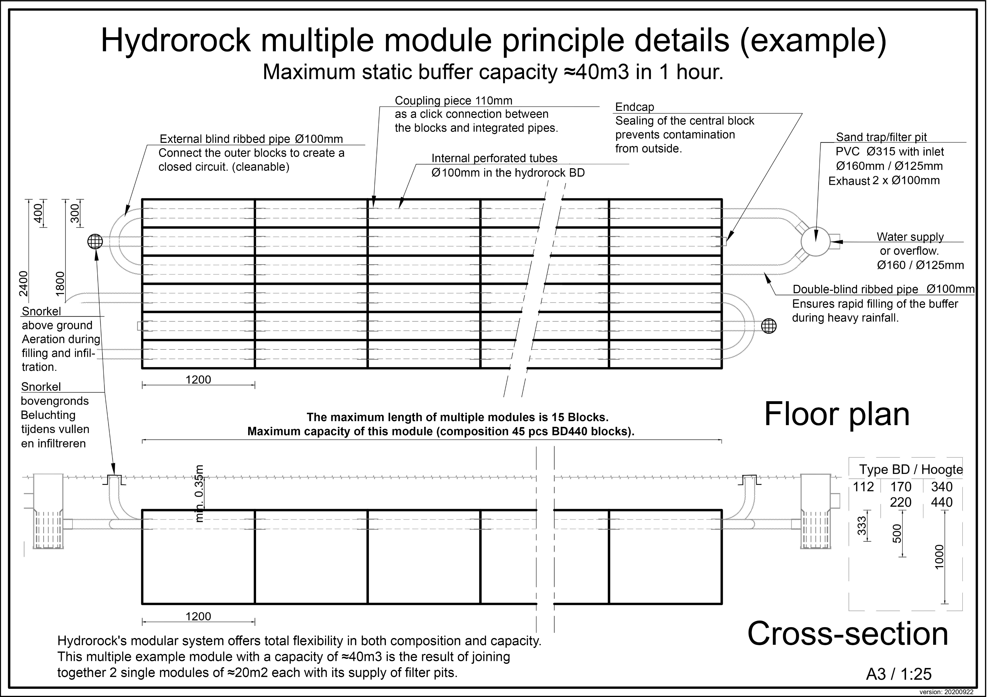
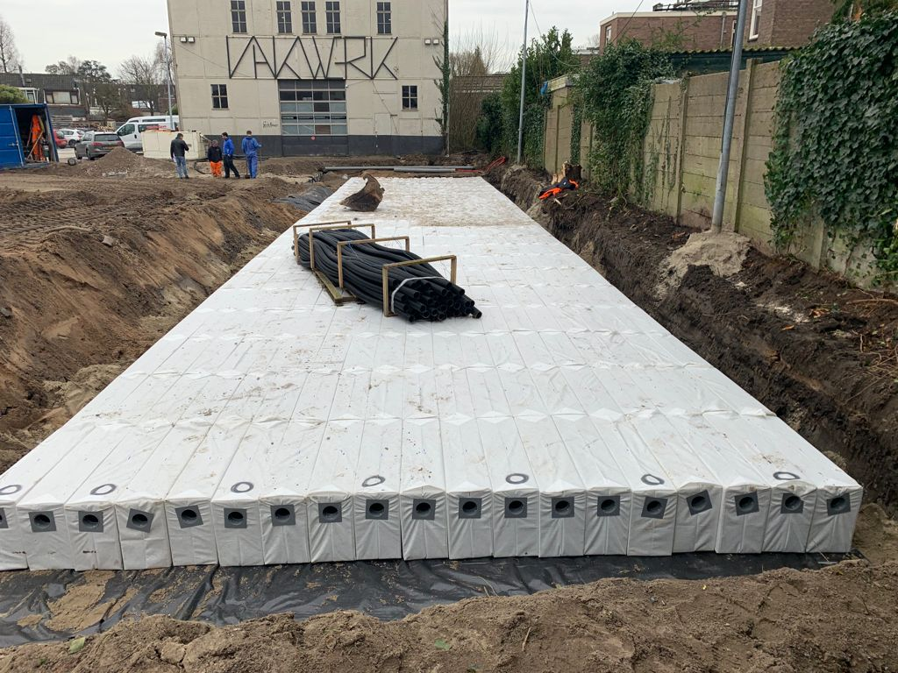
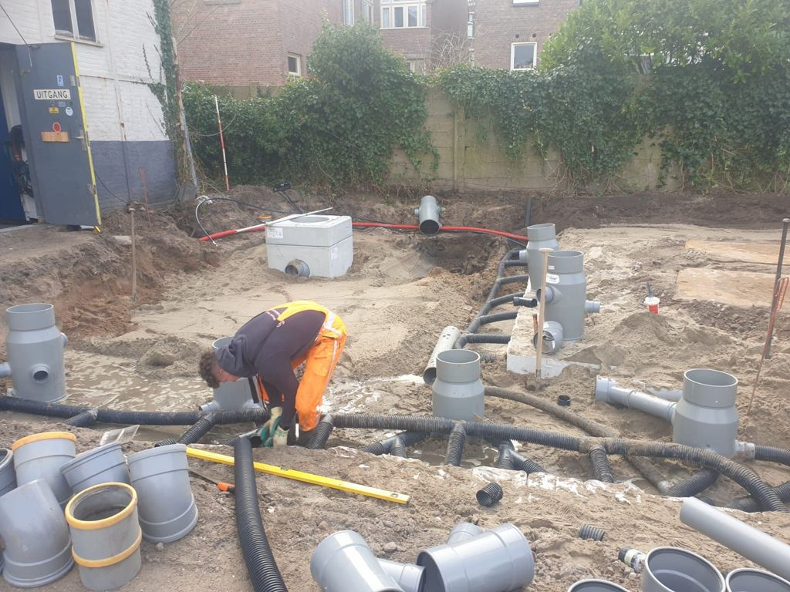
Hydrorock multiple module principle details

Slide 13
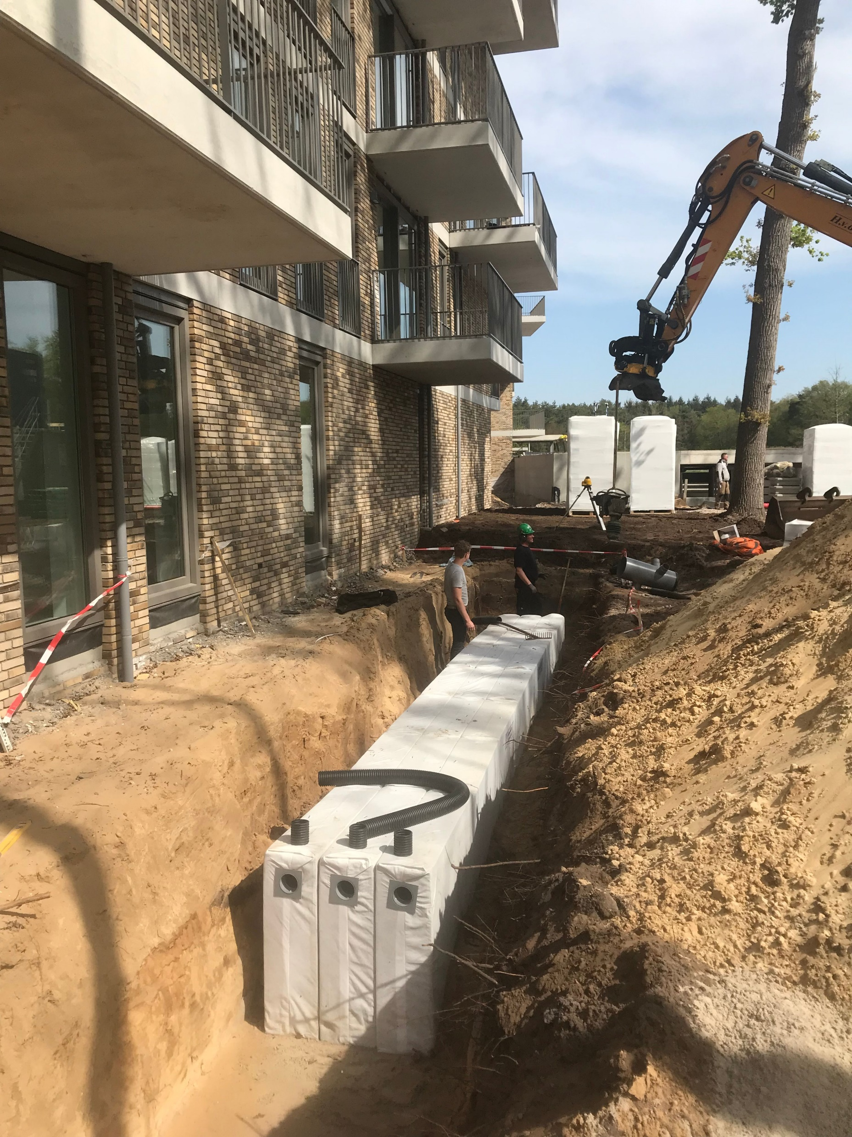
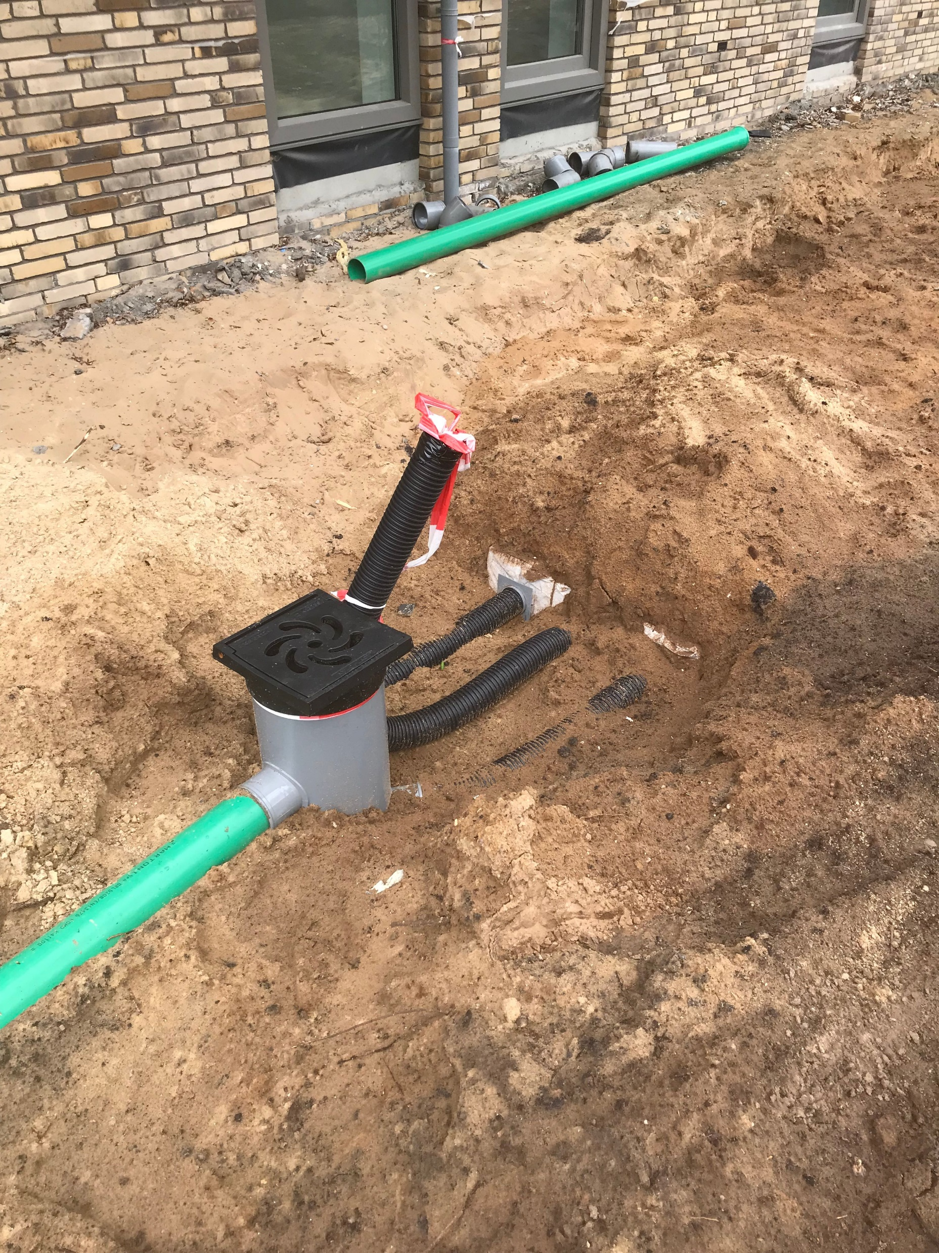
Project case
Case Hilversum Monnikenberg
Disconnecting of rainwater drains
The current water problems and drought are problems in both urban and rural areas. When there is a lot of precipitation the sewers become overcrowded with all its consequences. Many municipalities aim to infiltrate as much of the precious rainwater as possible into the soil in cases of drought and not to discharge it unnecessarily into the water purification system. For new buildings, the disconnection of rainwater is therefore already mandatory.

Slide 14
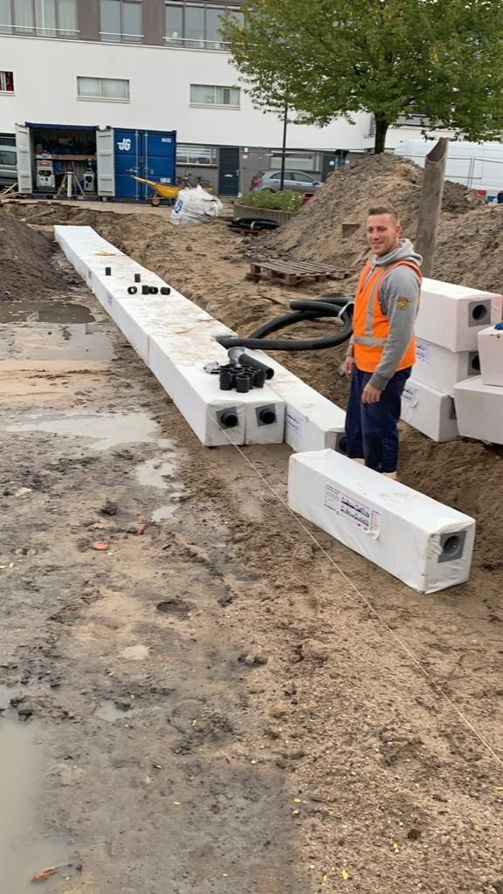
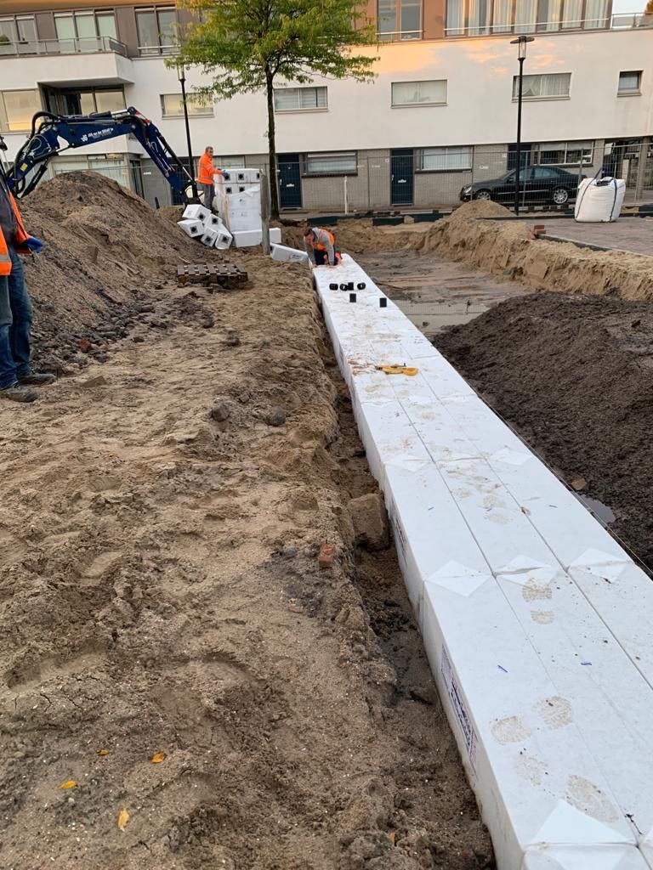
Project case
Case Dordrecht, Park solution
A simple solution for existing infrastructure
Water nuisance at car parks in Dordrecht. The capacity of the drainage system is insufficient during heavy rainfall and the car park is then flooded. With the installation of Hydrorock buffers, the excess water is now quickly absorbed. The infiltration blocks, which can buffer 95% of their volume in water, then gradually release the water into the ground. There will be no more puddles of water in the parking lot. The system can be used in existing situations, as the groundwork is limited compared to alternatives.

Slide 15
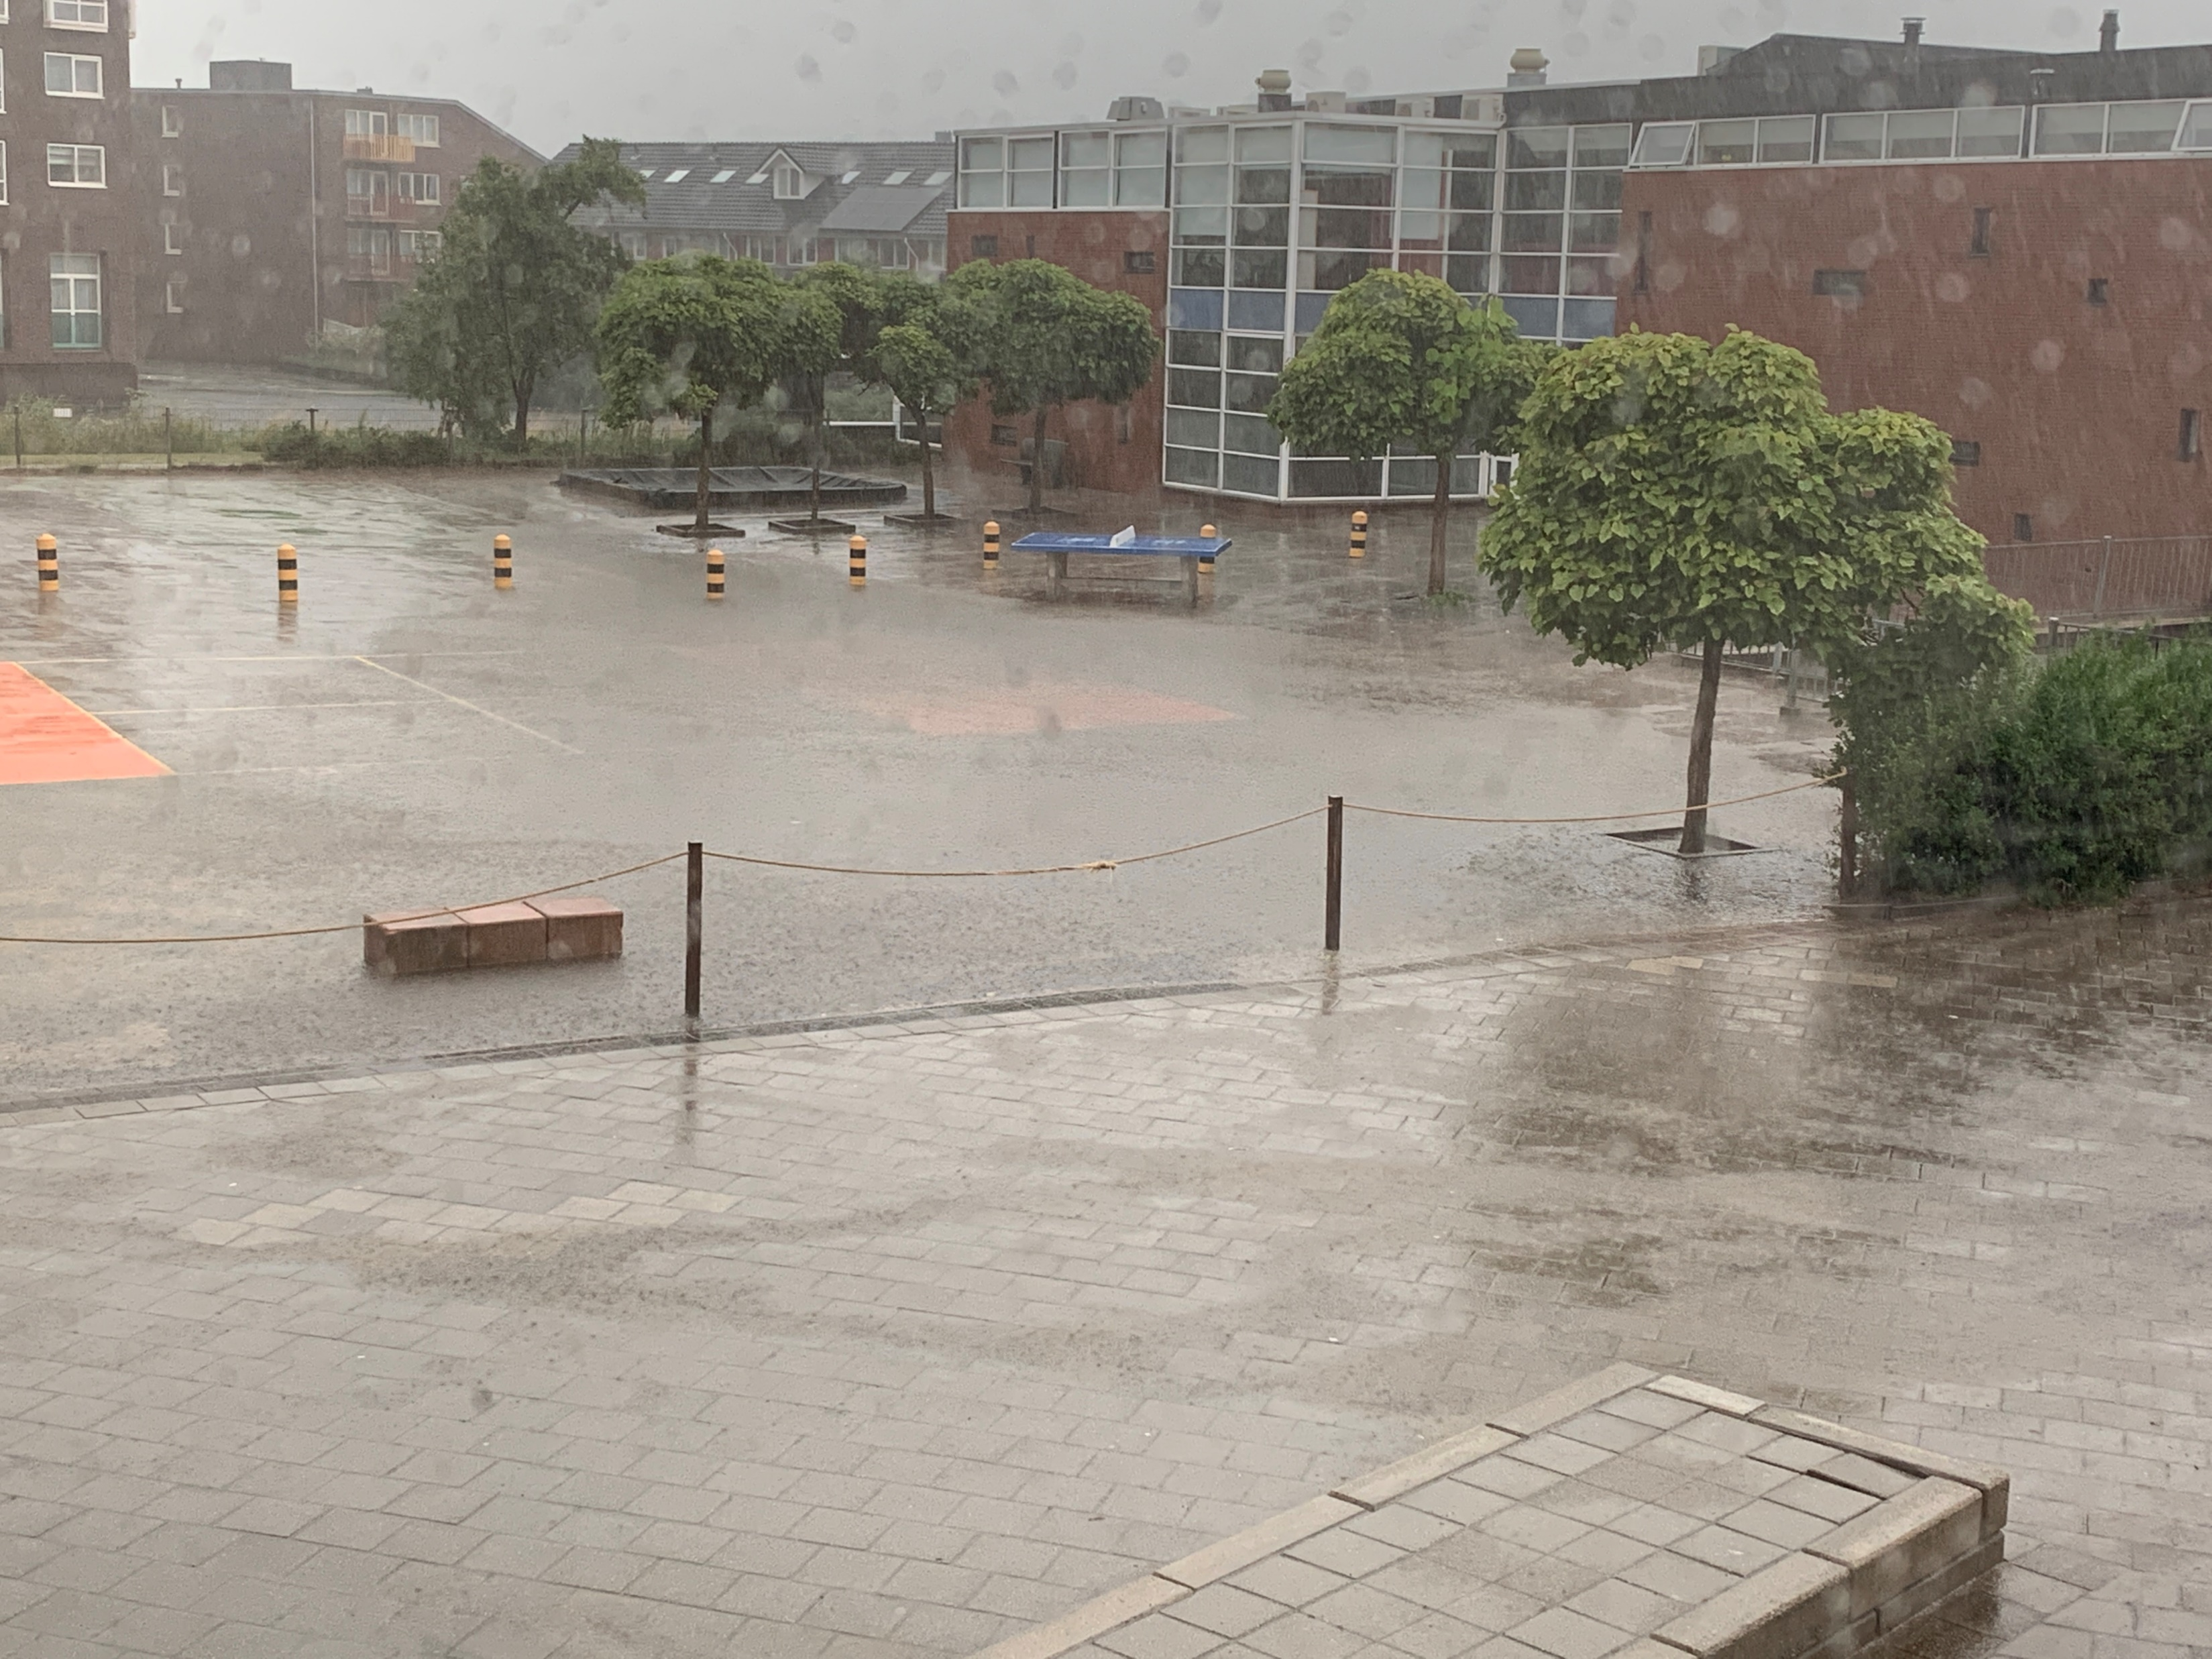
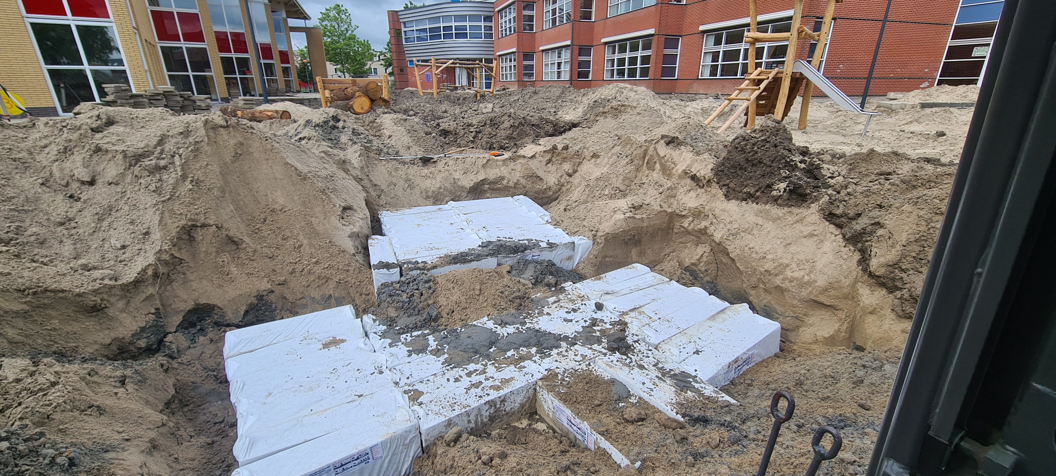
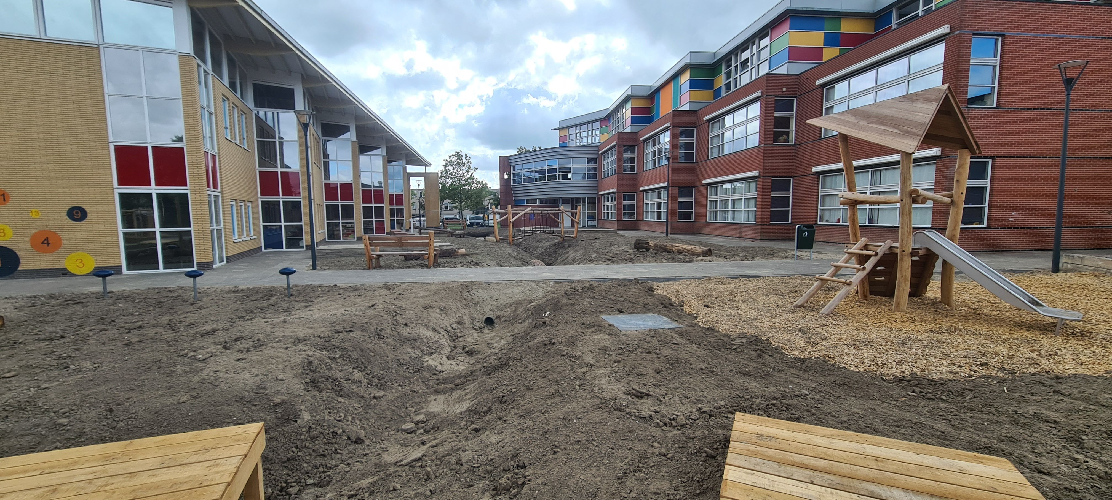
Project case
Case Schoolyard De Vlinder /
De Violier, Schiedam
Increasing sustainability and reducing flooding
We no longer want water to cause flooded playgrounds and then disappear into the sewers. That is the worst way to deal with rainwater.
Hydrorock water storage tanks are placed under the playground to retain the water longer. The square and the roof of the school buildings will be disconnected from the sewers.
Installation Hydrorock
Old situation
Ready for pavement

Slide 16
Summary
Life-long guarantee
Heavy duty
Max. 4.000 kg per m²
No plumbing required
Immediately
ready for use
100% environmentally friendly
100% Dutch

Slide 17
Questions & Answers
How many Hydrorock-blocks do I need?
Why is the use of Hydrorock dependant on soil type?
What load can Hydrorock handle?
Can Hydrorock be used with a high groundwater level?
What is the absorption capacity over time?
Is maintenance required?
Do you have any questions?

