Slide 1
EcoBloc Crated Sump Vs Hydrorock Aquifer System
Lizard Lane Horse Paddock Infiltration System (160m³ buffering Capacity)

Slide 2
System Comparison Summary
Crated Sump System Hydrorock Aquifer System
Cannot be used - doesn’t fit within the site Can be readily used – easily fits within site
Installed cost over twice that of Hydrorock Installed cost less than 40% that of Crated Sumps
Involve extensive traffic management (Diversion) Involves minimal or no traffic management
Take over 3 times as long as Hydrorock Less than 1/3 of time of Crated Sumps
Environmentally unfriendly – burying plastic Truly Green SuDS – much smaller LCA footprint

Slide 3
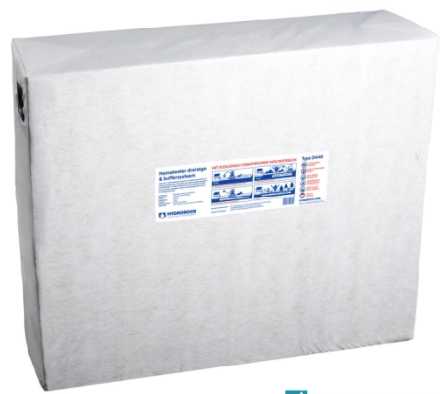
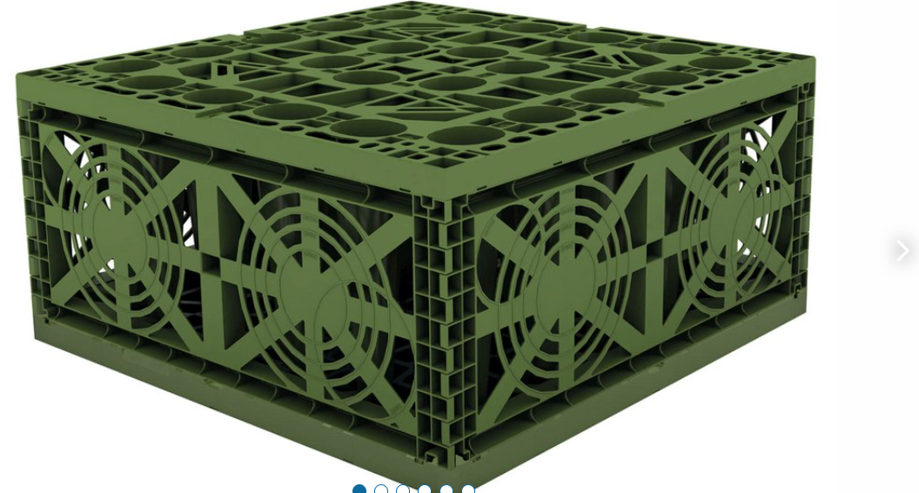
Plastic Crate vs Stonewool Aquifer Block
Graf EcoBloc Light
Hydrorock BD440
0.8m Long
0.8m Wide
0.35 High
Gross Volume 225 L
Reservoir Volume 219 L
1.2m Long
0.4m Wide
1.0m High
Gross Volume 480 L
Reservoir Volume 440 L

Slide 4
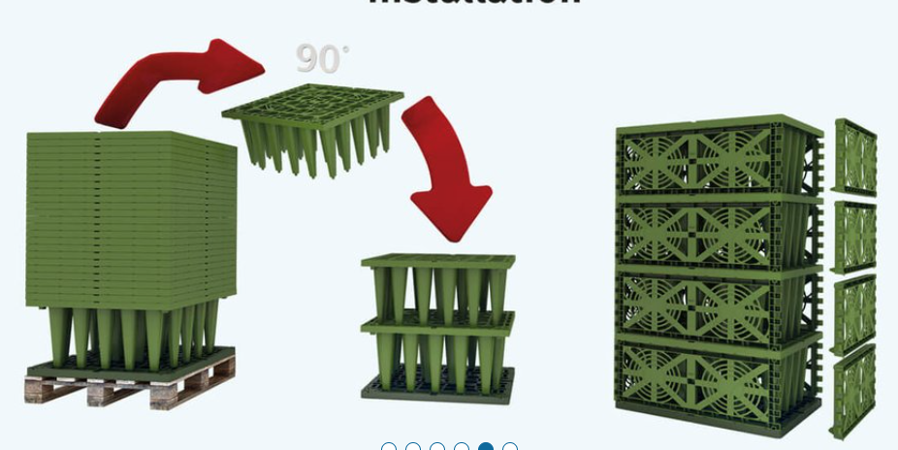
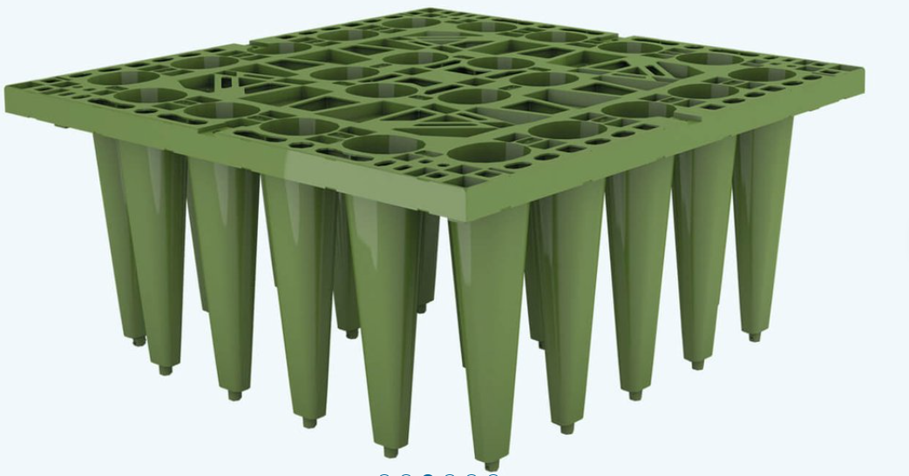
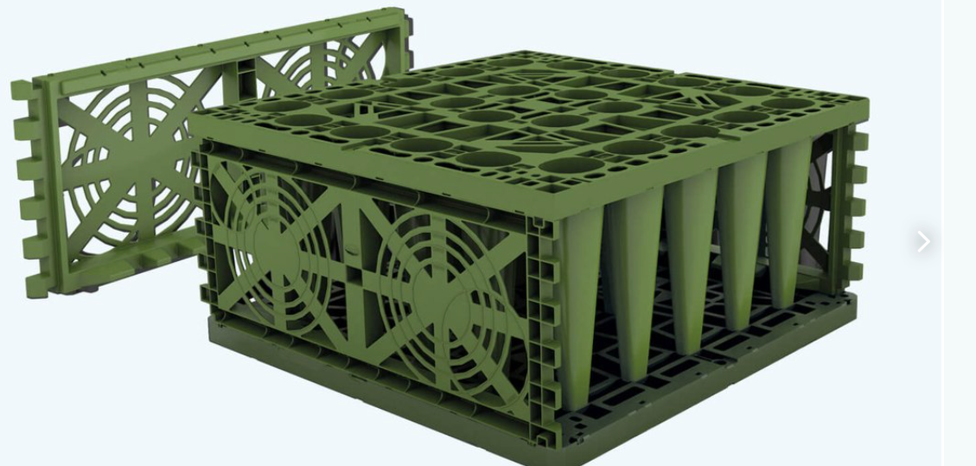
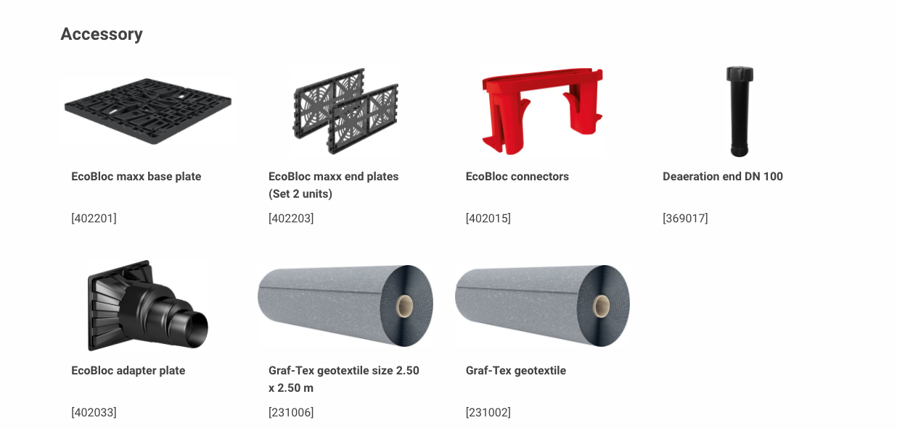
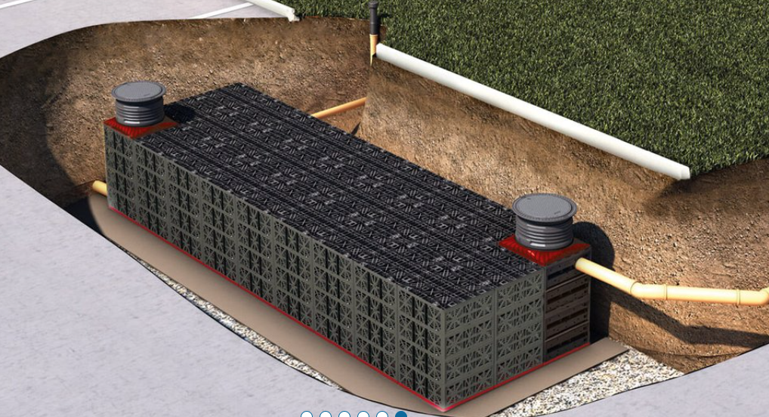
Graf EcoBloc Plastic Crated Sump System
Crates are far more time consuming to install – require expertise / special equipment / higher skill levels
Require individually assembly - careful stacking and proper fastening to ensure structural integrity – whole system has to be most carefully wrapped and sealed in geotextile – carefully backfilled

Slide 5
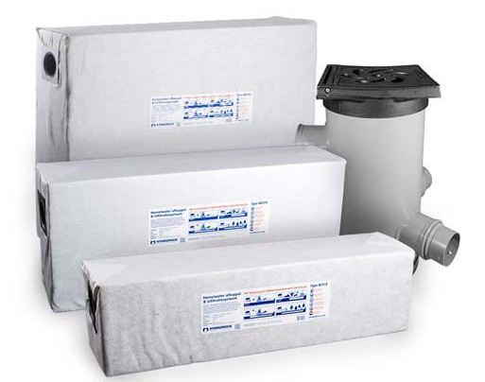
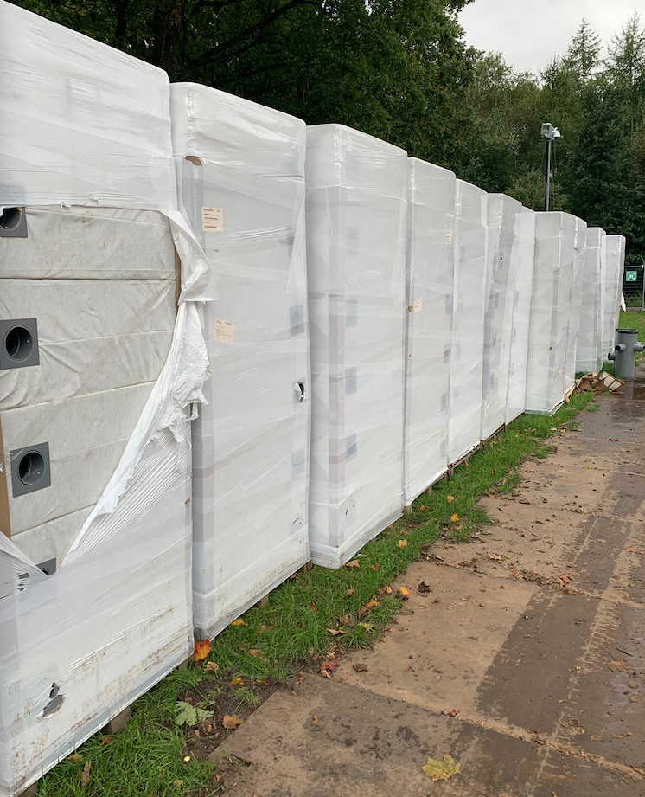
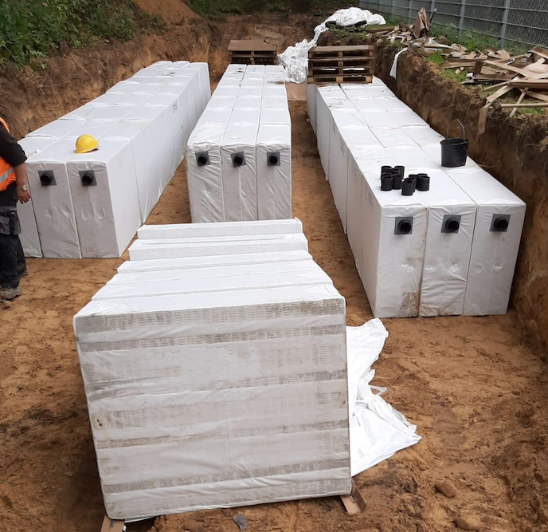
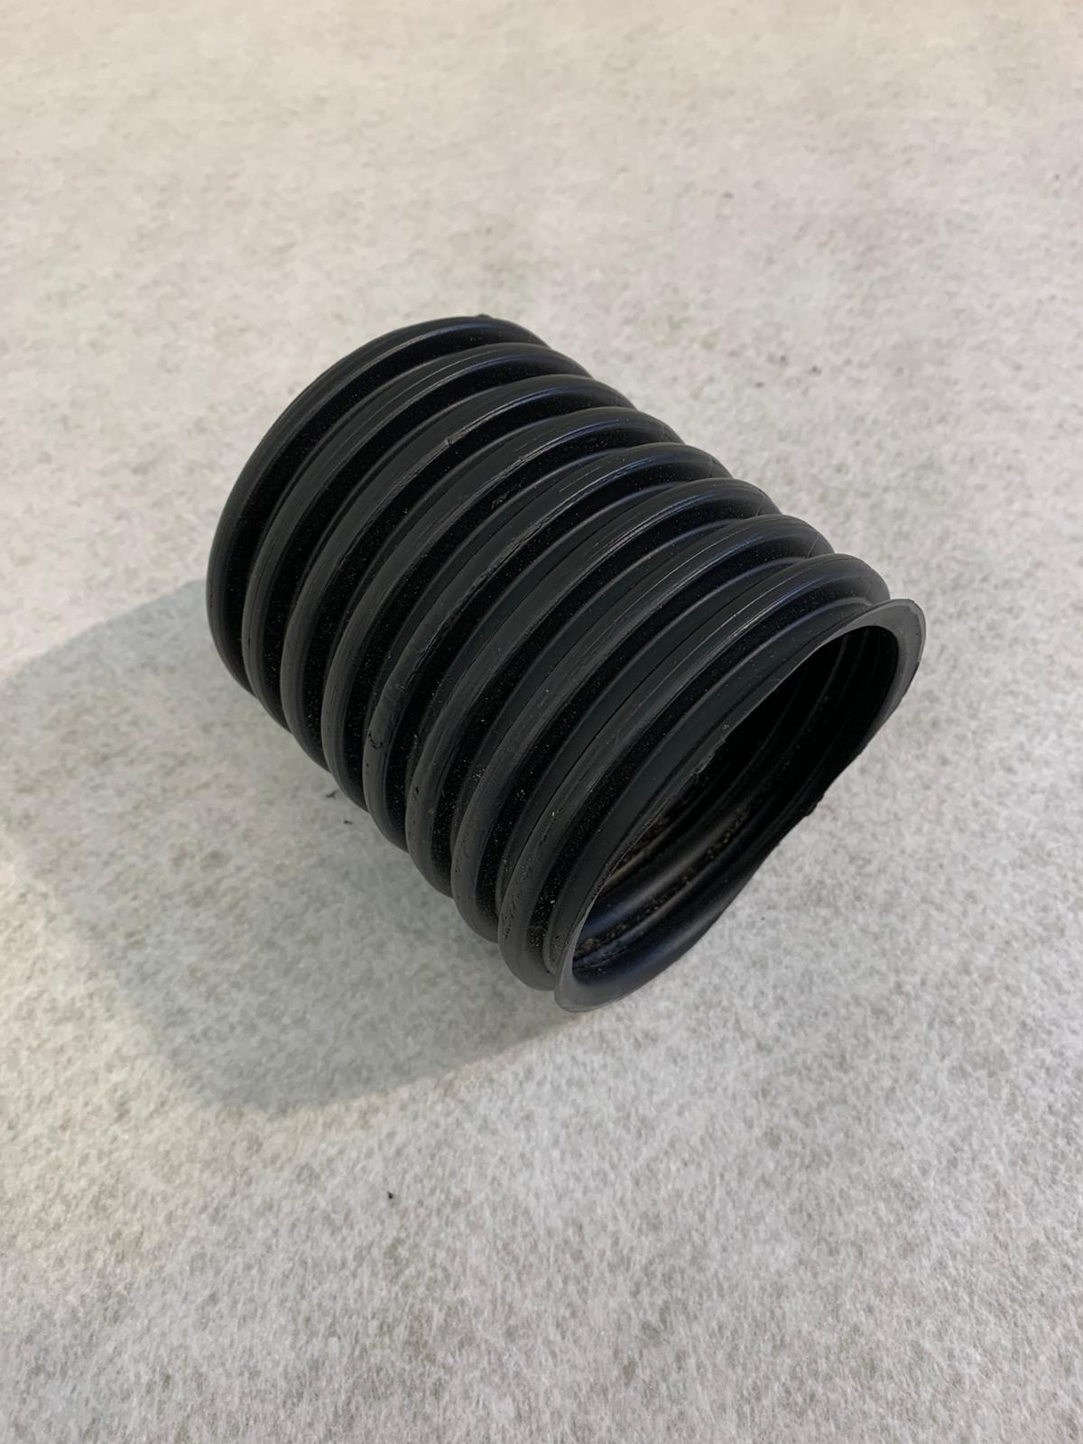
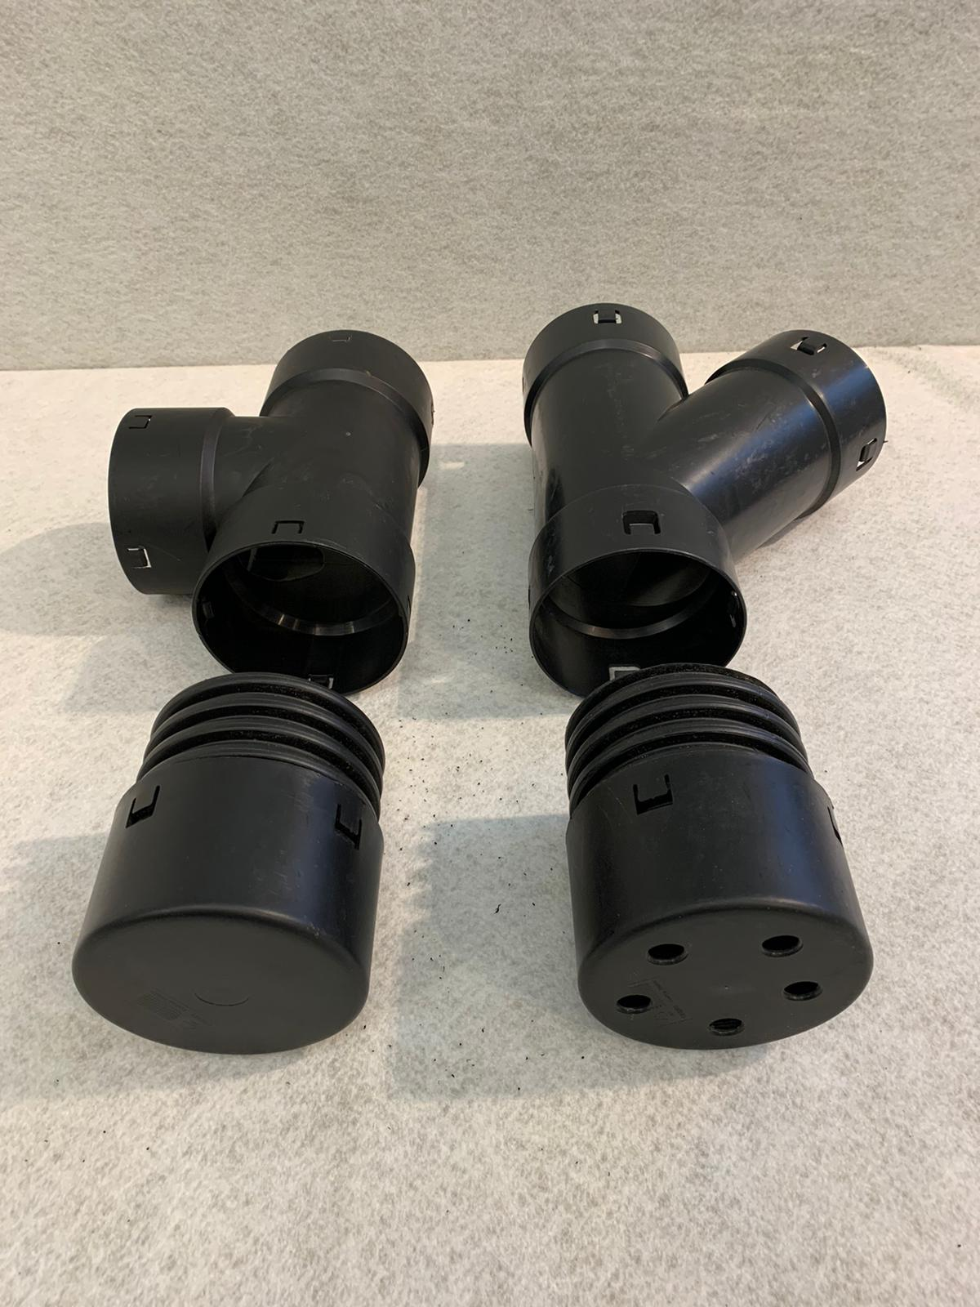
Hydrorock Natural Aquifer System
Hydrorock Blocks are very simple, easy and fast to install – require only basic equioment & no special skills
Blocks arrive on site ready-wrapped in geotextile membrane – simply placed in trench and rapidly connected with simple snap-together fittings – trench is immediately & quickly backfilled

Slide 6
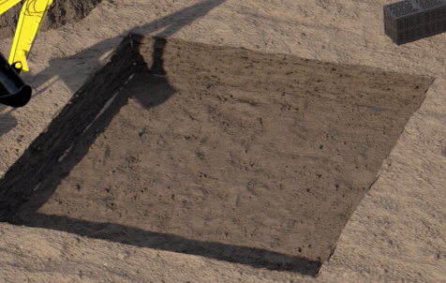
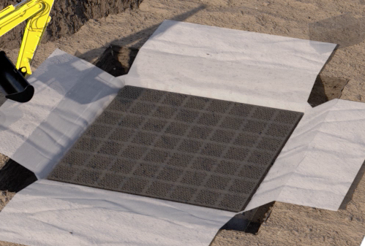
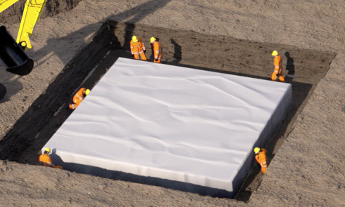
Plastic Crate Installation – Oversized Excavation / Delayed Backfill
Complete excavation required before geotextile membrane can be laid in trench and crate assembly begin – excavation remains fully open until system wrapped and ready for backfilling
Oversized excavation (1m around sides) required to enable crew to walk around system while assembling and fastening crates together, before completing wrapping

Slide 7
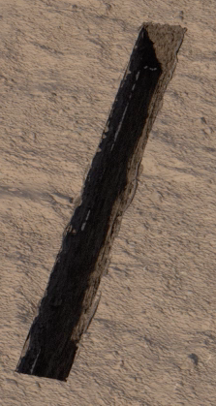
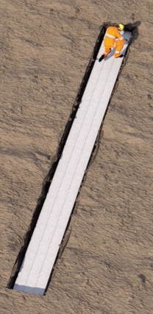
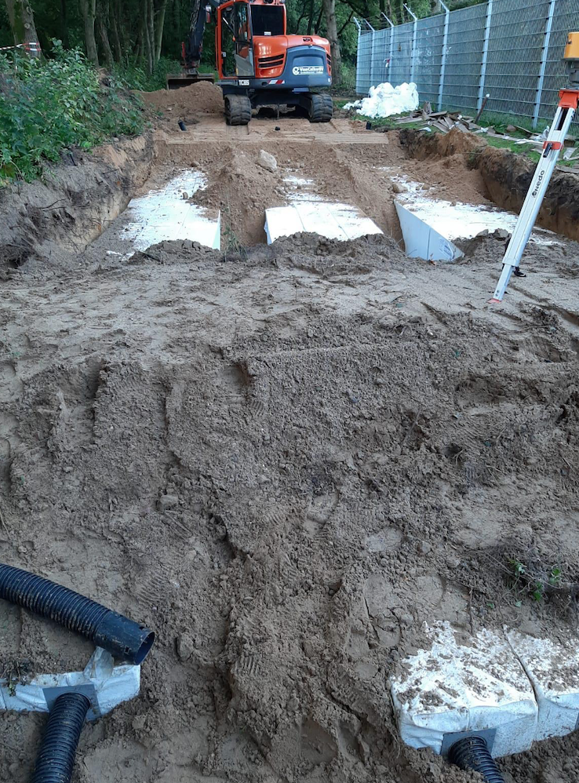
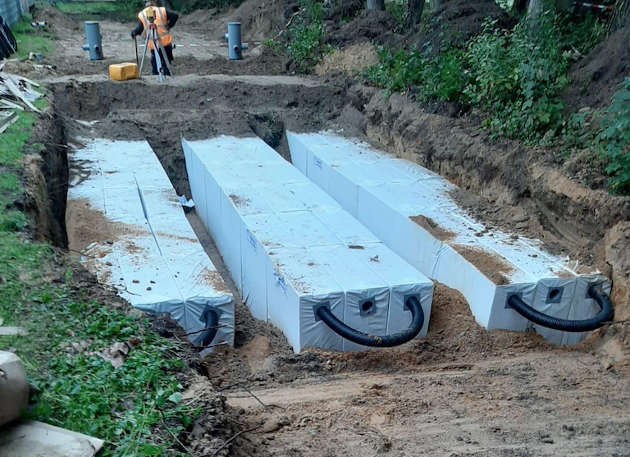
Aquifer Block Installation – Rightsize Excavation / Immediate Backfill
Ready-wrapped Aquifer Blocks enable rightsized excavation (maximum 10cm around sides) – minimising excavation and avoiding operation disrution of repeated handling, and highway obstruction from soil storage
Excavation / Installation / backfill can be undertaken very simply and rapidly in a single operation

Slide 8
System Size Comparison Required To Buffer 160m³ (within 1st hour of rain event)
Crated Sump System volume has to be 69m³ more (over 50% larger) than Hydrorock Aquifer System
Plastic Crated Sump System - 201m³ (918 Crates)
Crated sumps retain ~25% of system cubic water volume due to insufficient hydrostatic pressure to fully empty the system
System must be ‘oversized’ 25% to ensure storage capacity availability - to buffer 160m³ crated sump system must be oversized by 40m³ (25% of 160m³)
Hydrorock Aquifer System - 132m³ (300 Blocks)
Hydrorock Aquifer Blocks infiltrate immediately water enters the system (due to capillary action and ability to infiltrate through the bottom of the system)
In first hour of a rain event the system buffers the Static Capacity of the Blocks (130m³) as well as 1 hour of infiltration (30m³/hr) - giving System Dynamic Capacity of 160m³ (130m³ + 30m³)
Therefore, to buffer 160m³ the Hydrorock Aquifer System’s Static Capacity can be downsized by 30m³ (130m³)

Slide 9
Configuration of Systems
Crated Sump System
918 Crates (918 x 219L = 201m³)
Stacked 3 crates wide (3 x 0.8m = 2.4m wide)
Stacked 3 crates high (3 x 0.35 = 1.05 high)
Stacked 102 crates long (102 x 0.8m = 81.6m long)
Hydrorock Aquifer System
300 Blocks (300 x 440L = 132m³)
Stacked 6 Blocks wide (6 x 0.4 = 2.4m)
Stacked 1 Block high (1 x 1.0m = 1.0m high)
Stacked 50 Blocks long (50 x 1.2m = 60m long)
System Footprint 196m² (81.6m x 2.4m)
System Gross Volume 207m³ (918 x 225L)
Excavation Footprint 368m² (83.6 x 4.4m)
Total Excavation Volume 552m³ (83.6 x 4.4 x 1.5m high)
Note:
Excavation requires additional 1.0m around System
Excavation 1.5m depth: 0.1m sand layer / 1.05m Crates / 0.35m overburden
System Footprint 144m² (60m x 2.4m)
System Gross Volume 144m³ (300 x 480L)
Excavation Footprint 156m² (60.2 x 2.6m)
Total Excavation Volume 235m³ (60.2 x 2.6m x 1.5m high)
Note:
Excavation requires additional 0.1m around System
Excavation 1.5m depth: 0.1m sand layer / 1.0m Blocks / 0.35m overburden / 0.05m Geogrids

Slide 10
System Footprint Comparison
Required Footprint for Crated Sump System is too big to fit Horse Paddock site
Site’s available installation space footprint - 185m²
Crated Sump System Footprint - 196m² (81.6m long x 2.4m wide)
Hydrorock Aquifer System Footprint - 144m² (60.0m long x 2.4m wide)
Crated Sump System Footprint is 52m² more (36% larger) than Hydrorock Aquifer System

Slide 11
System Excavation Footprint Comparison
Required Excavation Footprint for Crated Sump System is far too big to fit Horse Paddock site
Site’s available installation space footprint - 185m²
Crated Sump System Excavation Footprint - 368m² (83.6m long x 4.4m wide)
Hydrorock Aquifer System Excavation Footprint - 156m² (60.2m long x 2.6m wide)
Crated Sump System Excavation Footprint is 212m² more (236% larger) than Hydrorock Aquifer System

Slide 12
System Excavation Volume Comparison
Excavation Volume for Crated Sump System is 317m³ more ( 235% larger) than Hydrorock Aquifer System
Crated Sump System:
  Excavation Volume - 552m³ (83.6m long x 4.4m wide x 1.5m high)
  Excavation Weight - 717t (soil weight factor 1.3t per m³)
  Excavated Soil Volume - 717m³ (excavated soil swell factor 30%)
Hydrorock Aquifer System:
  Excavation Volume - 235m³ (60.2m long x 2.6m wide x 1.5m high)
  Excavation Weight - 305t (soil weight factor 1.3t per m³)
  Excavated Soil Volume - 305m³ (excavated soil swell factor 30%)

Slide 13
System Spoil-Away Volume Comparison
Spoil-Away for Crated Sump System is 66m³ more (28% larger) than Hydrorock Aquifer System
Crated Sump System:
  Spoil-Away Volume - 300m³ (Excavation 83.6m L x 2.4m W x 1.15m H = volume 231m³ x 1.3 swell factor)
  Spoil-Away Weight - 300t (Soil weight factor 1.3t per m³ was applied during excavation)
  No. Lorry Loads - 12 (26t lorries)
Hydrorock Aquifer System:
  Spoil-Away Volume - 234m³ (Excavation 60.2m L x 2.6m W x 1.15m H = volume 180m³ x swell factor)
  Spoil-Away Weight - 234t (Soil weight factor 1.3t per m³ was applied during excavation)
  No. Lorry Loads - 8 (excavated soil swell factor 30%)

Slide 14
System Backfill Volume Comparison
Backfill for Crated Sump System is 112m³ more (37% larger) than Hydrorock Aquifer System
Crated Sump System:
  Backfill Volume - 417m³ (717t Excavated Soil Volume – 300t Spoil-Away Volume)
  Backfill Weight - 417t (Soil weight factor 1.3t per m³ was applied during excavation)
Hydrorock Aquifer System:
  Backfill Volume - 305m³ (Excavation 60.2m L x 2.6m W x 1.15m H = volume 180m³ x swell factor)
  Backfill Weight - 305t (Soil weight factor 1.3t per m³ was applied during excavation)

Slide 15
Project Disruption / Inconvenience Comparison
Volume of excavation – Crated Sump system excavated soil will completely block road – Hydrorock could be managed on Verge or part of one lane of road
Traffic Management Sort-term Traffic Control with Hydrorock – Road Closure / Traffic Diversion with Crates
Site Movement – Vastly more Equipment Vehicle movement (HSE Risk) on and along road and on verge
Length of Time – Crates minimum 3 X longer than Hydrorock

Slide 16
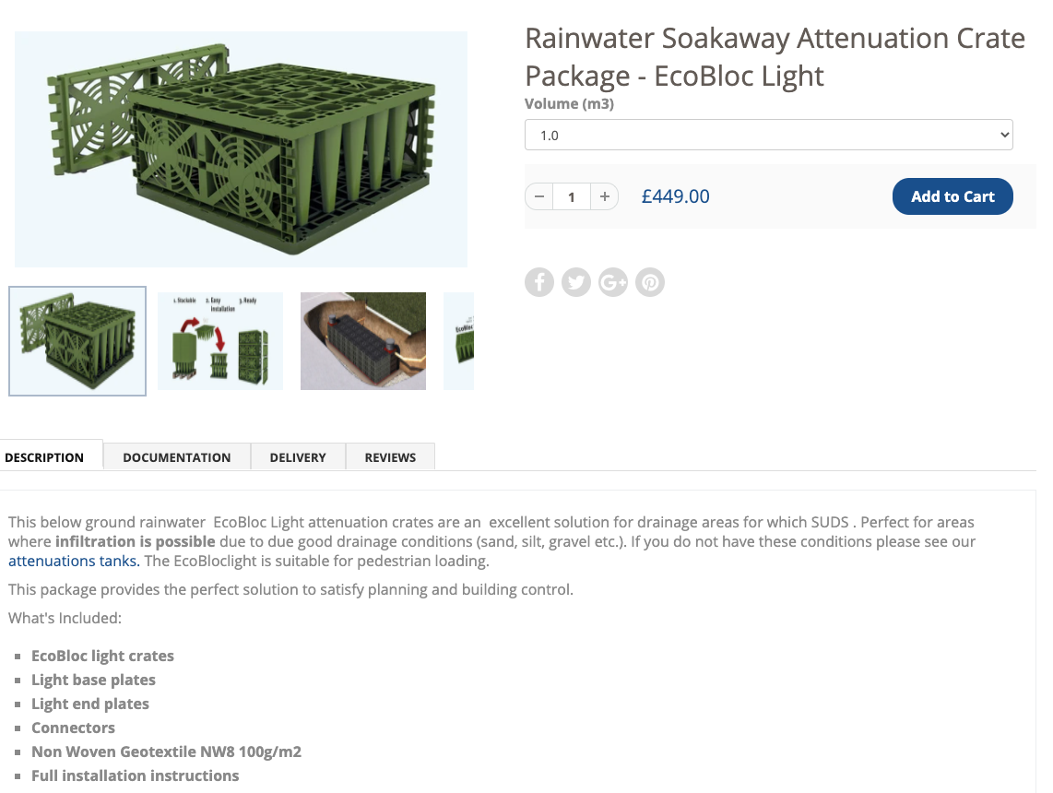
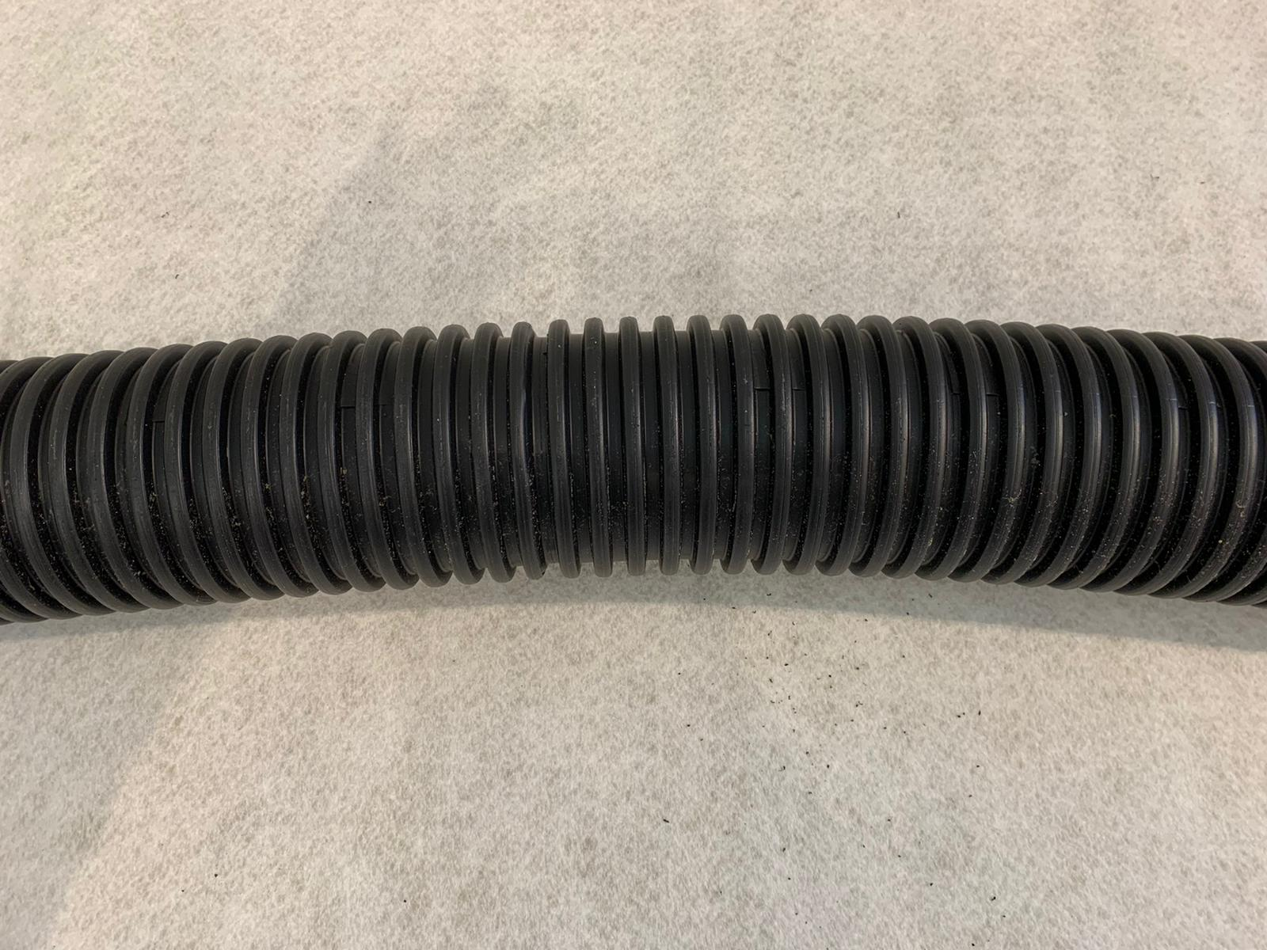
Cost Comparison
Crated Sump System:
Hydrorock Aquifer System:
Full Price of System per m³ - £511
25% Discount Price of System per m³ - £383
Cost includes all necessary ancillaries - such as connectors between Blocks / flexible piping / geogrids

Slide 17
Cost Comparison
Cost Comparison
Project cost of Hydrorock Blocks significantly less than Crates – Hydrorock Total installed cost less than 40% of Crates
Crated Sump System:
Hydrorock Aquifer System:
201m³ @ £449 / m³ = £90,249 132m³ @ £511 / m³ = £67,490
(Crates plus ancillaries) (Blocks plus ancillaries)
Plus currently uncosted additional activities, amounts Special Project discount price (-X%)
& volumes to those required for Hydrorock system 132m³ @ £XXX / m³ = £XX,XXX
Time assembling crates / system & wrapping system (Blocks plus ancillaries)
317m³ Additional Excavation
66t Additional Spoil-Away
112t Additional Backfill
7.5t Additional Drainage San
Road Traffic Management

Slide 18
System Infiltration Performance Comparison
Crated Sump System fails to leave Zero water on road within 6 hours
Mitigates Flooding by 25-year rain event (231m³)
Buffers ~ 70% of water (160m³) of rain event water in 1st hr
Less than ~ 30% (71m³) of rain event water on road at end of 1st hr
Zero water on road within 8hrs
50% Block capacity available within 14hrs
Blocks 100% empty within 21hrs
Mitigates Flooding by 25-year rain event (231m³)
Buffers ~70% (160m³) of rain event water volume in 1st hour
Less than ~ 30% (71m³) of rain event water on road at end of 1st hr
Zero water on road within 3.5hrs of rain event
50% of Buffered water capacity available within 6hrs of rain event
System 100% empty within 9hrs
Mitigates Flooding by 75-year rain event (331m³)
Buffers ~50% (160m³) of rain event water volume within 1st hour
Zero on road within 7hrs of rain event
50% of Buffered water capacity available within 10hrs of rain event
System 100% empty within 12hrs
Crated Sump System:
Hydrorock Aquifer System:
Hydrorock Aquifer System Mitigates 75-year rain event (331m³) better than Crated Sump System Mitigates 25-years

Slide 19
Environmental Comparison
Crated Sump System:
Made entirely from plastic
Involves burying huge amount of plastic in the ground
Creates microplastic into the water system
Hydrorock Aquifer System:
Aquifer System is truly Green SuDS
Made from 100% natural material (Basalt Rock)
Minimises amount of plastic buried in the ground
Does not put microplastics into water
Filters road surface runoff – cleaner water discharge to soil

Slide 20
Hydrorock Lifecycle Analysis Comparison with Plastic Crates

